Slide 1
OCCUPATIONAL ERGONOMICS
Chapter 11
WORKPLACE ANALYSIS

Slide 2
WORKPLACE ANALYSIS
Learning Objectives
At the conclusion of this chapter, learners will be
able to:
  Prioritize workstation evaluations
  Conduct a workstation evaluation and identify the ergonomic risk factors present
  Recommend modifications to reduce ergonomics risk
  Validate changes made in order to document decrease in ergonomic risk factors

Slide 3
WORKPLACE ANALYSIS
This chapter:
  Outlines ways to identify workstation for evaluation by analyzing available information,
  Recommends a workstation evaluation system that helps to identify the severity of ergonomic risk factors through the use of ergonomics evaluation models,
  Reviews methods for developing recommendations to reduce the risk factors present in a task or operation, and
  Proposes ways to validate the effectiveness of implemented recommendations.

Slide 4
WORKPLACE ANALYSIS
Workstation analysis follows a standard problem solving procedure such as that suggested by Barnes (1980), which includes:
  Accurately defining the problem,
  Analyzing the problem,
  Searching for possible solutions,
  Evaluating the alternatives,
  Recommending an action, and
  Following up on the changes that were made.

Slide 5
WORKPLACE ANALYSIS
Graphical representation of the Ergonomic Evaluation Process.
Preliminary Data Analysis
Workstation Prioritization
Observation & Walkthrough
Video Tape Activities
Worker & Workstation Measurement
Assessment and Analysis
Recommendations, Controls & Abatement
Follow Up

Slide 6
WORKPLACE ANALYSIS
1. Preliminary Data Analysis
The first step in accurately defining the problem is to take a broad look at information for the department or area to be analyzed. The information will consist of:
  Determination of the workstation, tasks, or operations present,
  Review of injury records,
  An analysis of the current discomfort level of the workers,
  A discussion of important relevant non-ergonomic factors such as hours worked (including overtime), age of workers, years of work experience, and worker turnover.

Slide 7
WORKPLACE ANALYSIS
  a. Workstation Flow Diagram
The flow diagram can include information such as workstation name, key workstation operations or tasks, processing time, material inputs (types and locations of bins or holders), machine process information (including machine time).
  b. Injury Records Review
All of the injury records for the facility or department for the previous three to five years. The easiest and most common form of injury records are the OSHA 300 logs and injury investigation forms. This will provide a general idea of the types of injuries that have occurred.

Slide 8
  c. Pareto Analysis
The ergonomist uses Pareto analyses to concentrate greatest effort on the few jobs that produce most of the concern (such as cost, frequency, severity, etc.).
  d. Pie Chart
May be used to show the number of injuries attributed to a particular workstation, operation or task as compared to all of the injuries that occurred during a given time period. May also be used to depict the percentage of budget that will be used to implement specific recommendations.

Slide 9
WORKPLACE ANALYSIS
  e. Trend Analysis
Some useful trends to analyze include discomfort or injuries by body part, by task, by shift, by time of the day, by gender, by years of experience, by age, or by worker turnover.
2. Prioritization of Workstations
Criteria are:
    severity of injuries that have occurred at a given workstation
    frequency of workstation injuries
    number of employees that could be affected by changes to a particular workstation or work area
    estimated cost of controls

Slide 10
WORKPLACE ANALYSIS
3. Data Collection and Evaluation Models
The steps involved are:
  Observation and walkthrough
    First key to workstation evaluation. Goal is to get a general feel of the types of
    work being conducted, the layout of workstation, and the risk factors that are present.
    At the end worker should be asked about the specific order of operations, duration of the shift, breaks, and overtime.
  Video tape activities
    Tape at least 3-5 cycles, or 10 minutes whichever is longer. For a short cycle time, 10-20 cycles are optimal, covering every side of the worker. Video tape of the work area and layout should also be taken. Type and size of material handling bins, carts, workstation location, activation lever locations, hand tools, and other key components should also be taped.

Slide 11
WORKPLACE ANALYSIS
  Worker and workstation measurement (Tables 11.1, 11.2; pp 163)
    Both worker and workstation should be measured. Important worker measurements include standing knuckle height, standing or seated elbow height, standing or seated eye height, popliteal height, if seated, and thigh height, if seated.
    For workstation, height, reach distances to objects, height reach of activation buttons, and height and reach of product jigs and fixtures, should be taken.
    If material handling is performed, all related measurements should be taken.
    If hand tools are used, all attributes of hand tools should be measured.
    For force application, estimation of force should be made and compared with the maximum and should be classified as low (< 30% of the max), medium (30-50% of the max), and high (50-100% of the max).

Slide 12
WORKPLACE ANALYSIS
  Worker and workstation measurement (Tables 11.1, 11.2; pp 163)
    Both worker and workstation should be measured. Important worker measurements include standing knuckle height, standing or seated elbow height, standing or seated eye height, popliteal height, if seated, and thigh height, if seated.
    For workstation, height, reach distances to objects, height reach of activation buttons, and height and reach of product jigs and fixtures, should be taken.
    If material handling is performed, all related measurements should be taken.
    If hand tools are used, all attributes of hand tools should be measured.
    For force application, estimation of force should be made and compared with the maximum and should be classified as low (< 30% of the max), medium (30-50% of the max), and high (50-100% of the max).

Slide 13
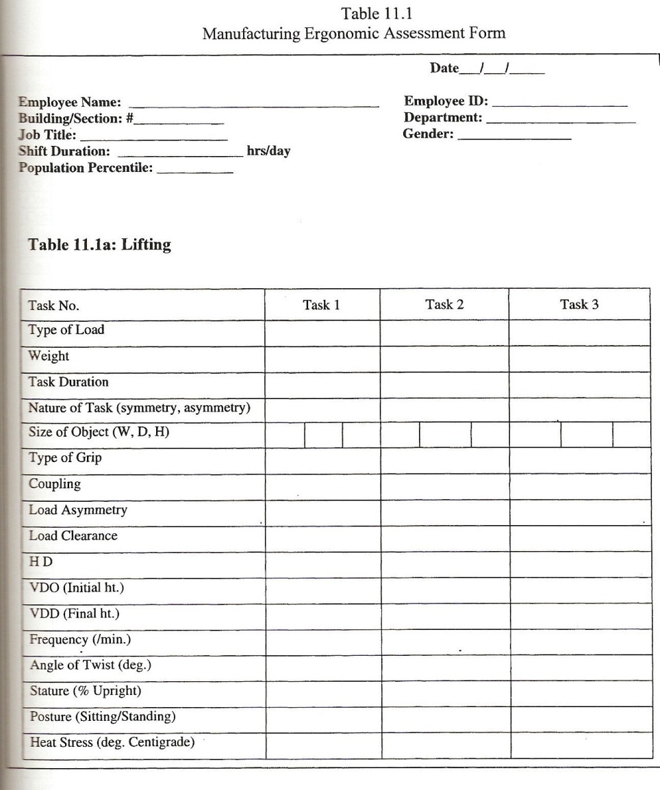
WORKPLACE ANALYSIS

Slide 14
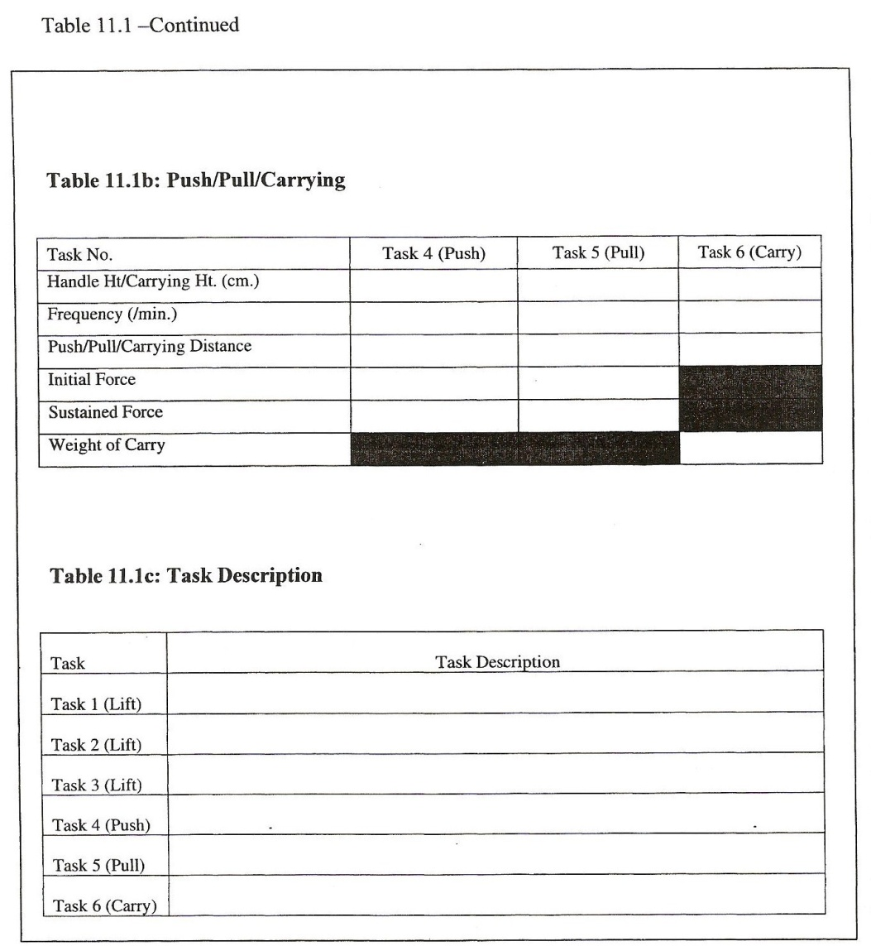
WORKPLACE ANALYSIS

Slide 15
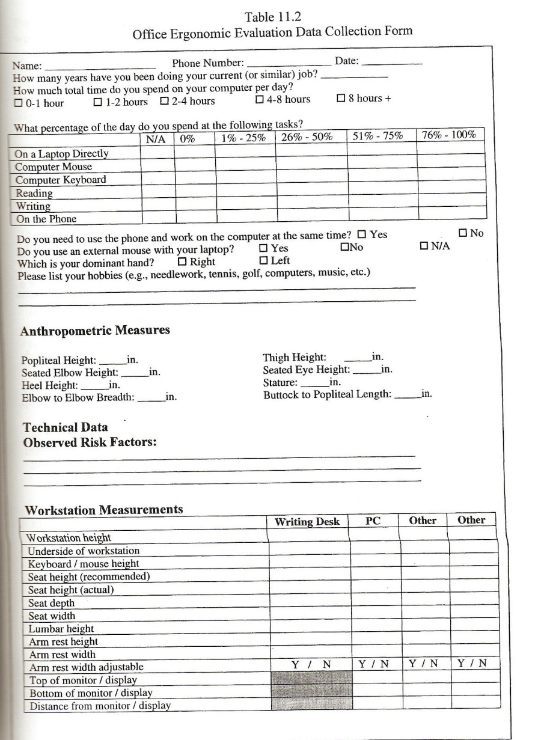
WORKPLACE ANALYSIS

Slide 16
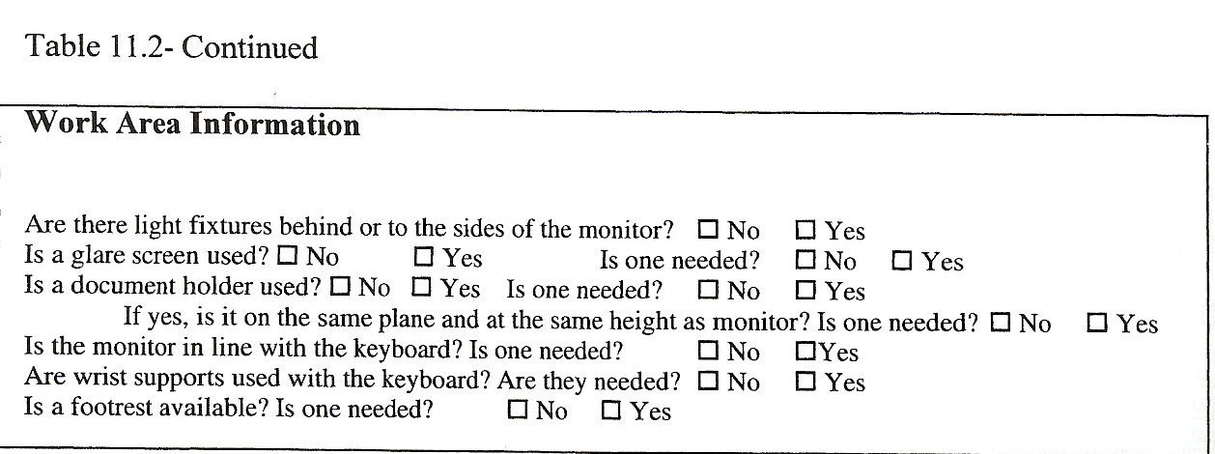
WORKPLACE ANALYSIS

Slide 17
WORKPLACE ANALYSIS
  Worker and management input
    Worker should be asked to identify the most difficult task, the task they least like to perform, the task that causes them most discomfort, and what changes they would like to make to their workstation.
    The management should be asked about the budget, design, and other constraints.
    Body Part Discomfort Survey

Slide 18
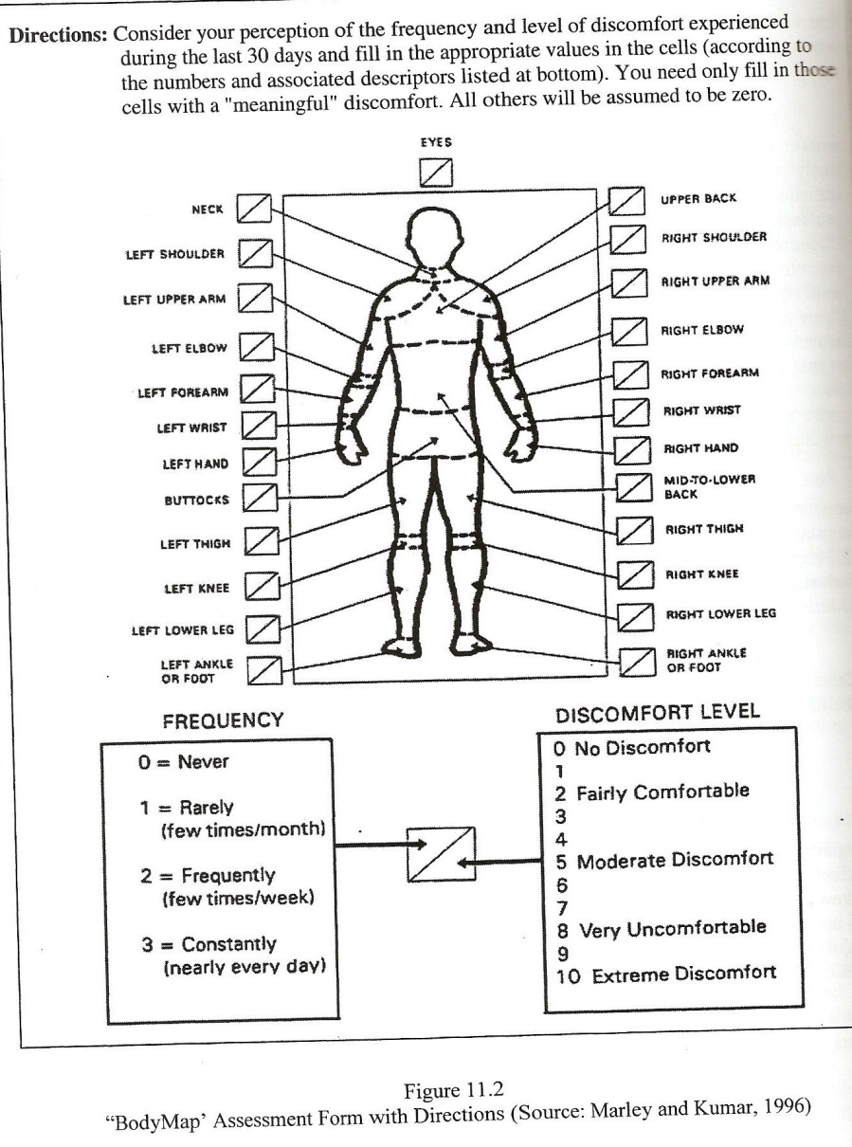
WORKPLACE ANALYSIS

Slide 19
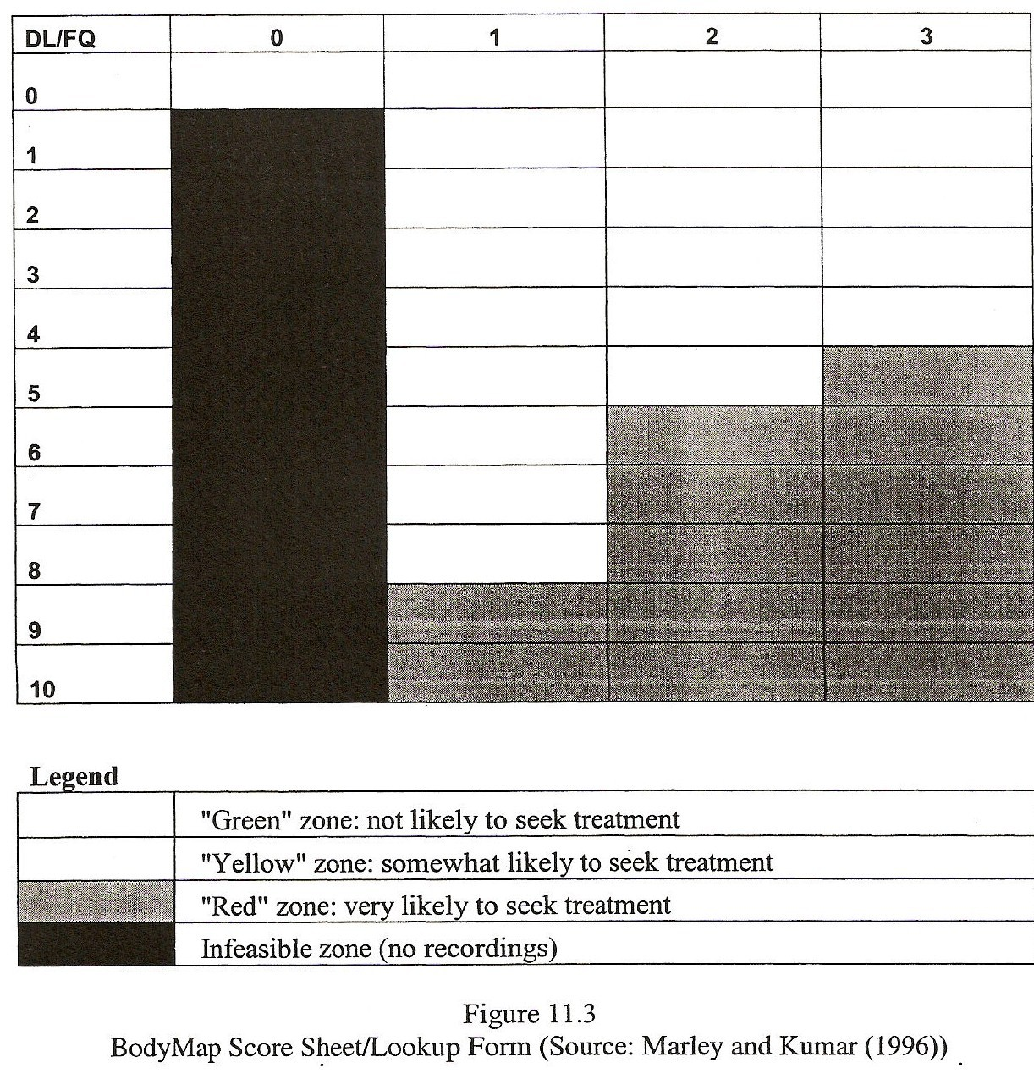
WORKPLACE ANALYSIS

Slide 20
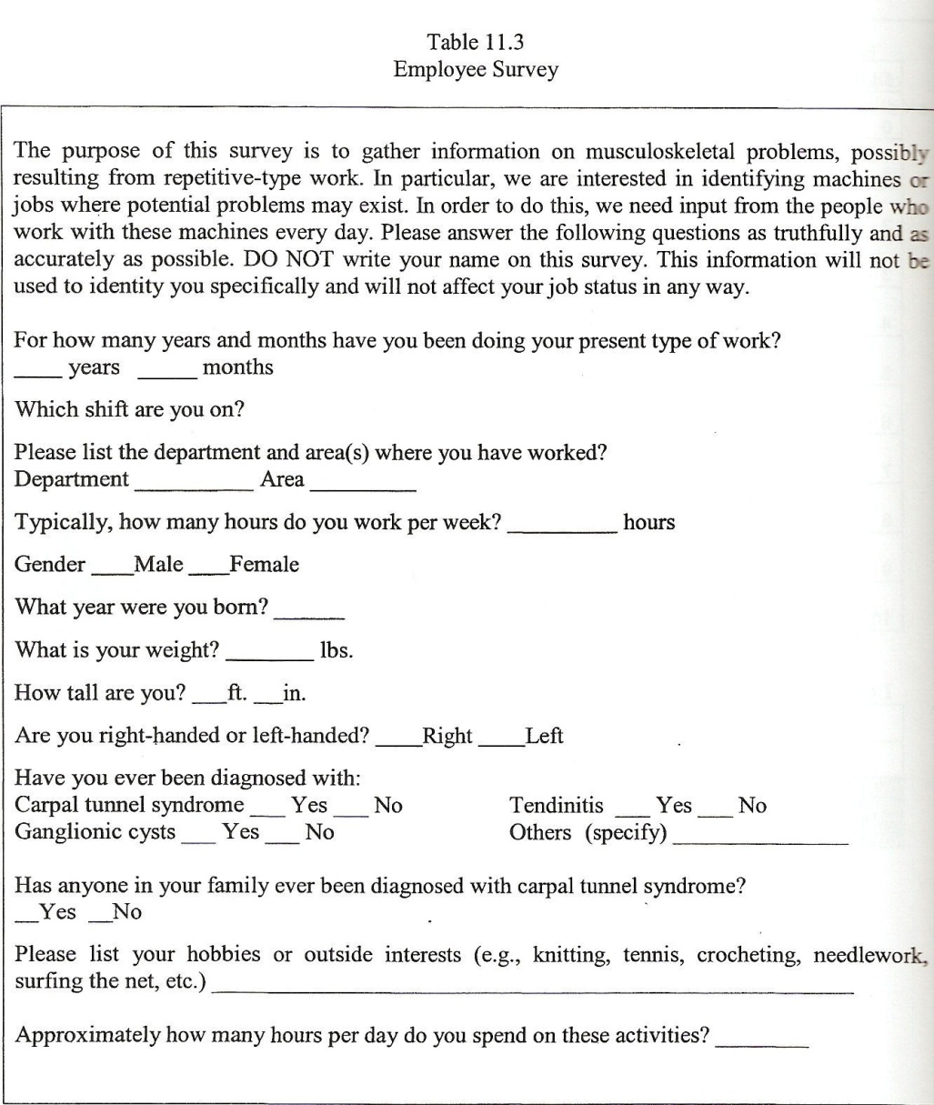
WORKPLACE ANALYSIS

Slide 21
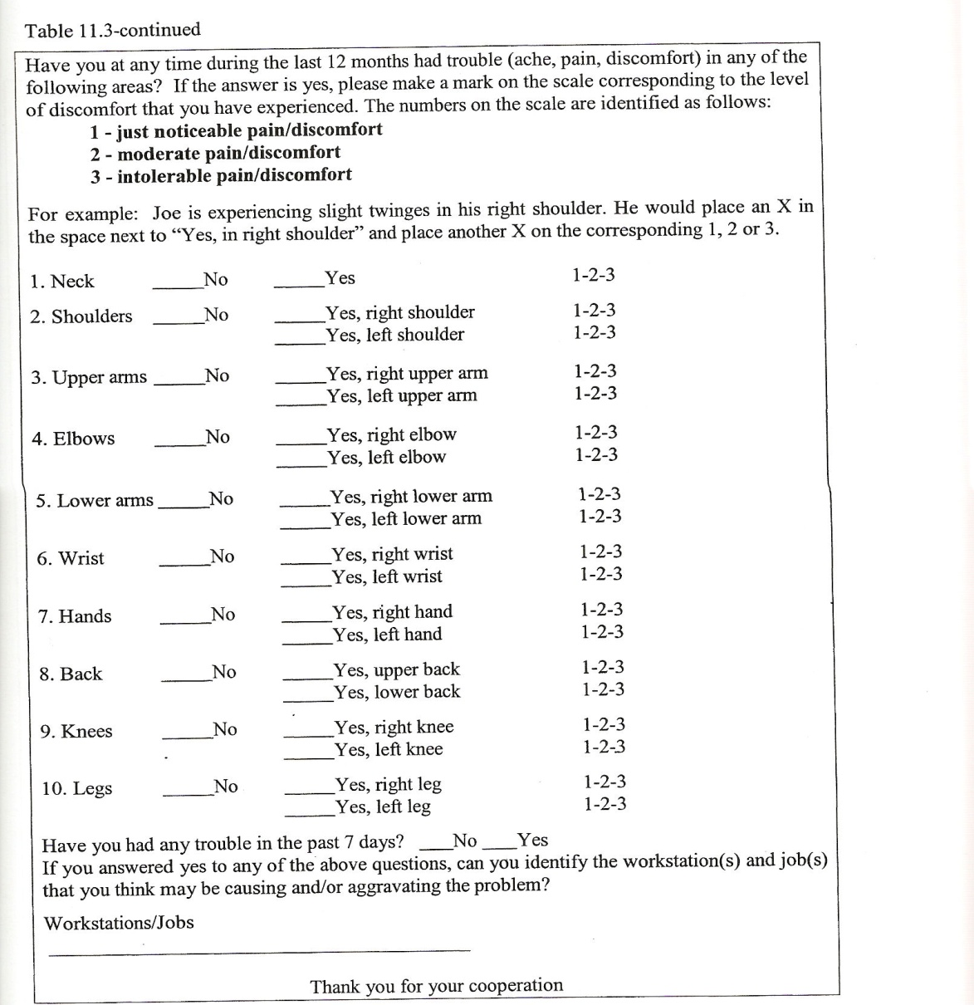
WORKPLACE ANALYSIS

Slide 22
WORKPLACE ANALYSIS
  Assessment and analysis
    Video Analysis (Table 11.4)
    Fishbone Diagram
    Strain Index
    Rapid Upper Limb Assessment (RULA)
    Rapid Entire Body Assessment (REBA)
    Ovako Working Posture Analyzing System (OWAS)
    Lumbar Motion Monitoring (LMM)
    Michigan 3D Static Strength Prediction Program (3DSSPP)

Slide 23
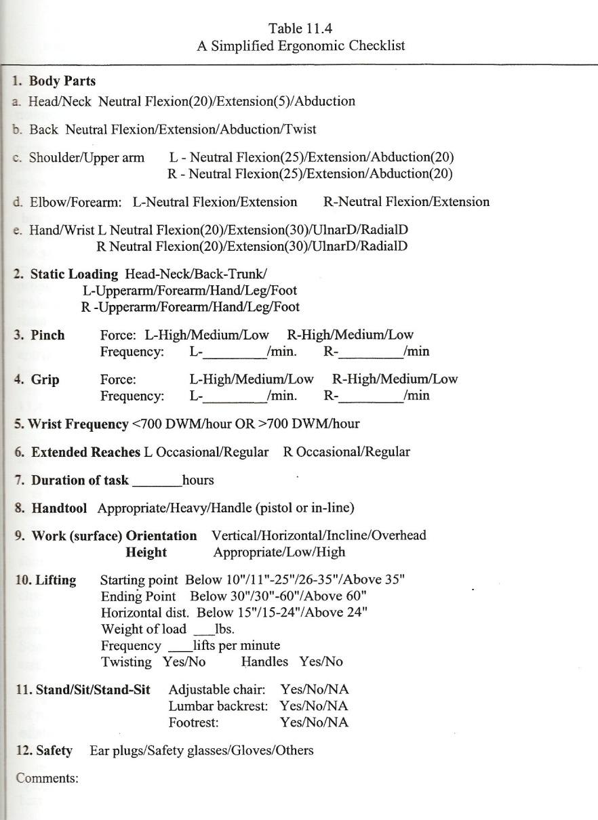
WORKPLACE ANALYSIS

Slide 24
WORKPLACE ANALYSIS
  Identification of risks
  Recommendations, controls, and abatement
    Implementation of Controls
  Follow up

