Slide 1
PROBABILITY AND STATISTICS FOR ENGINEERS - I
Chapter 5
PROBABILITY DENSITIES

Slide 2
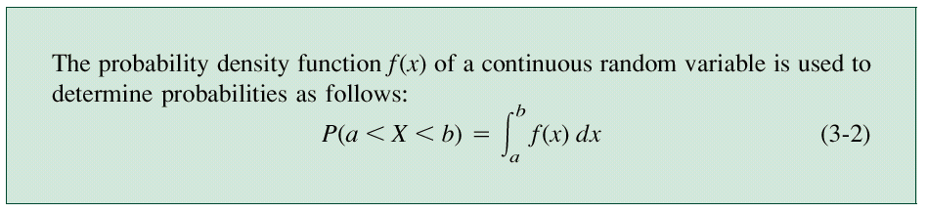
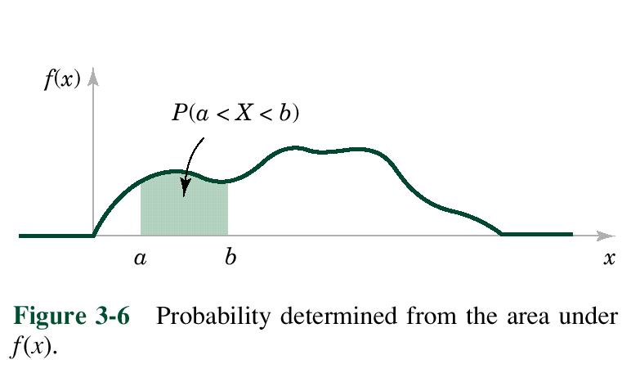
PROBABILITY DENSITIES
5.1 Continuous Random Variables
Probability density function

Slide 3
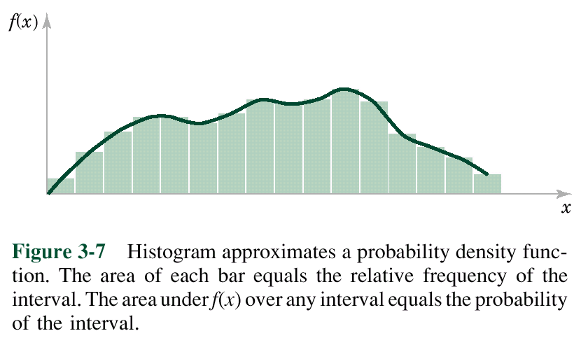
PROBABILITY DENSITIES
5.1 Continuous Random Variables
Probability density function

Slide 4
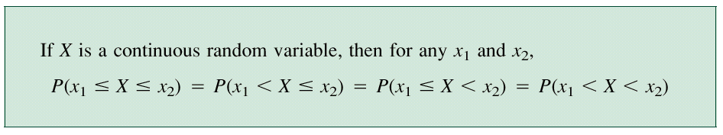
PROBABILITY DENSITIES
5.1 Continuous Random Variables
Probability density function

Slide 5
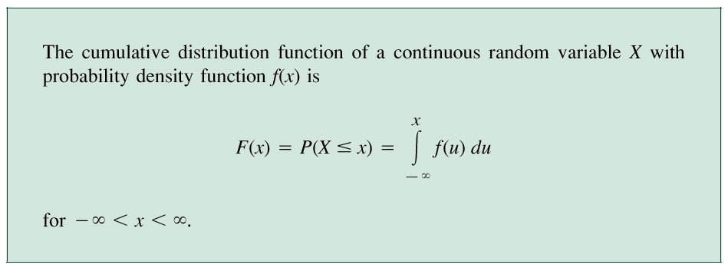
PROBABILITY DENSITIES
Cumulative distribution function

Slide 6
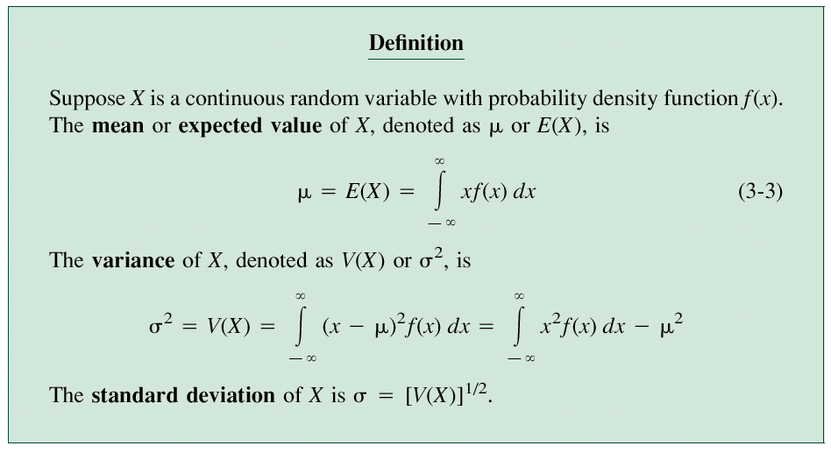
PROBABILITY DENSITIES
Mean and Variance

Slide 7
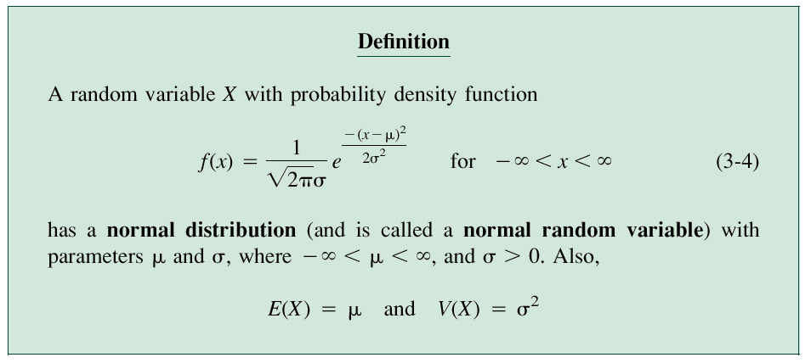
PROBABILITY DENSITIES
5.2 The Normal Distribution

Slide 8
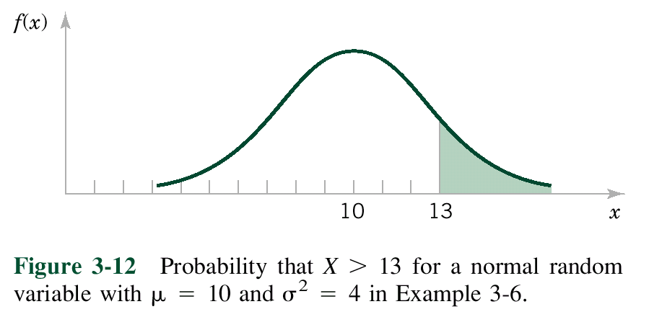
PROBABILITY DENSITIES

Slide 9
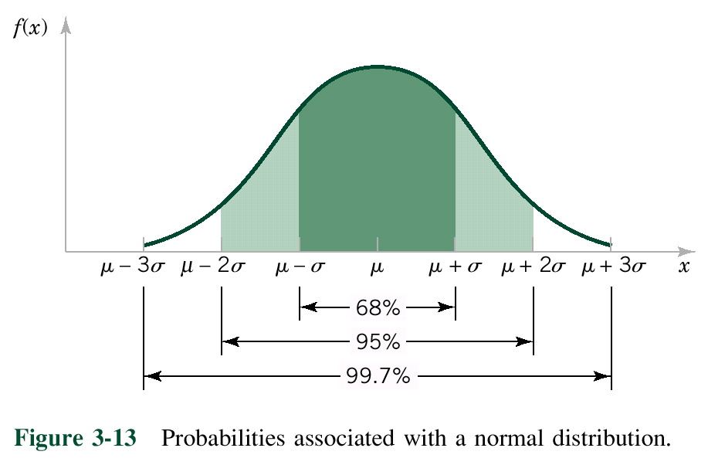
PROBABILITY DENSITIES

Slide 10
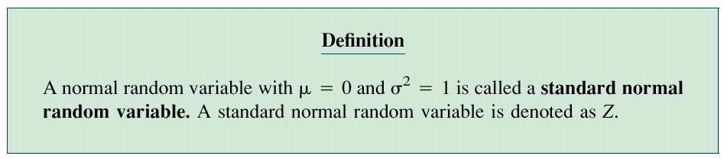
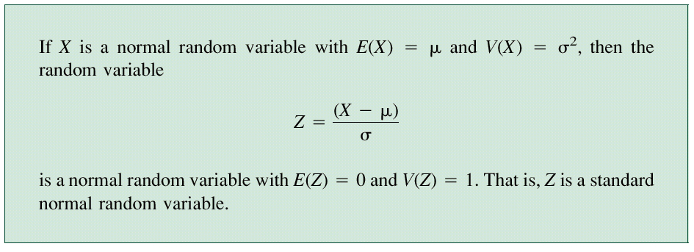
PROBABILITY DENSITIES
Standard Normal Distribution
Standardization

Slide 11
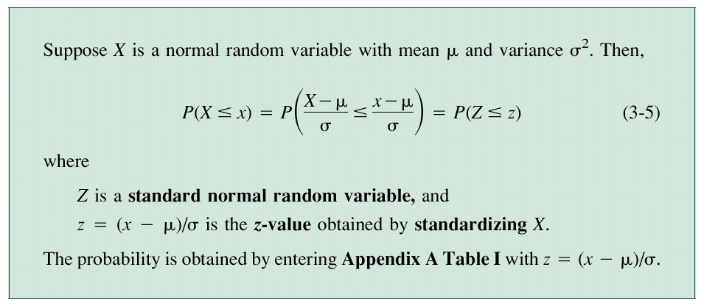
PROBABILITY DENSITIES

Slide 12
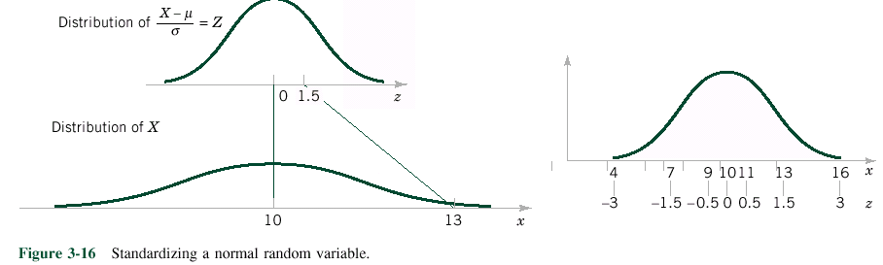
PROBABILITY DENSITIES
Examples on page 126-131.

Slide 13
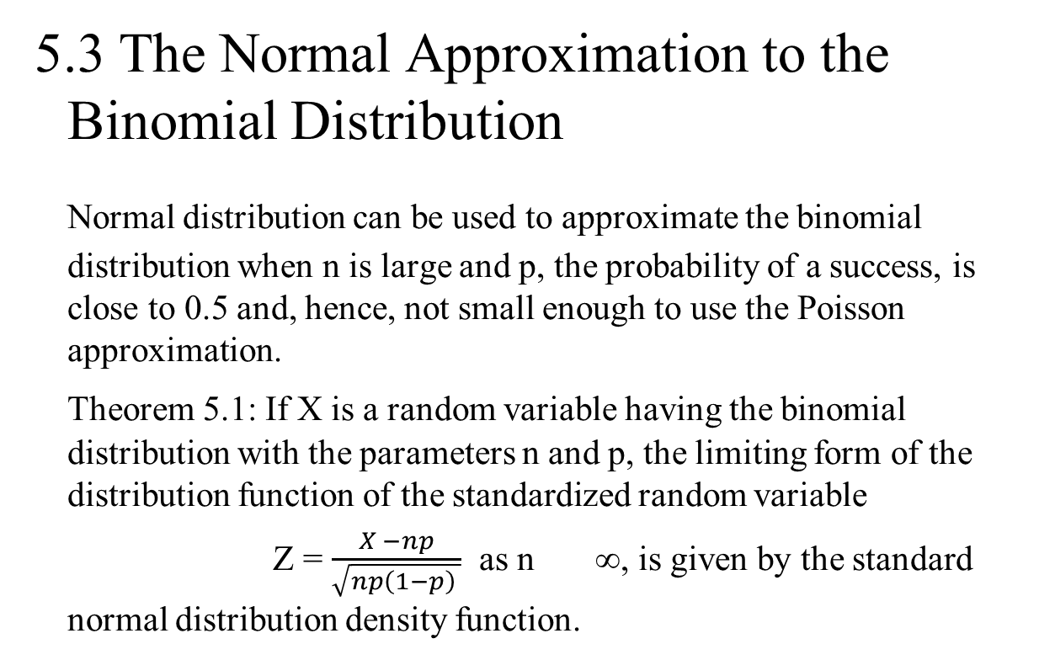
PROBABILITY DENSITIES
5.3 The Normal Approximation to the Binomial Distribution
Normal distribution can be used to approximate the binomial distribution when n is large and p, the probability of a success, is close to 0.5 and, hence, not small enough to use the Poisson approximation.
Theorem 5.1: If X is a random variable having the binomial distribution with the parameters n and p, the limiting form of the distribution function of the standardized random variable
Z = $\frac{X −np}{\sqrt{np\left(1−p\right) }}$ as n ∞, is given by the standard normal distribution density function.

Slide 14
PROBABILITY DENSITIES
5.4 Other Probability Densities
Other distributions that are used in engineering and physical sciences are t, F, and chi square distributions. Five continuous distributions which are often used in the field of Engineering and sciences are discussed in the remainder of this chapter.

Slide 15
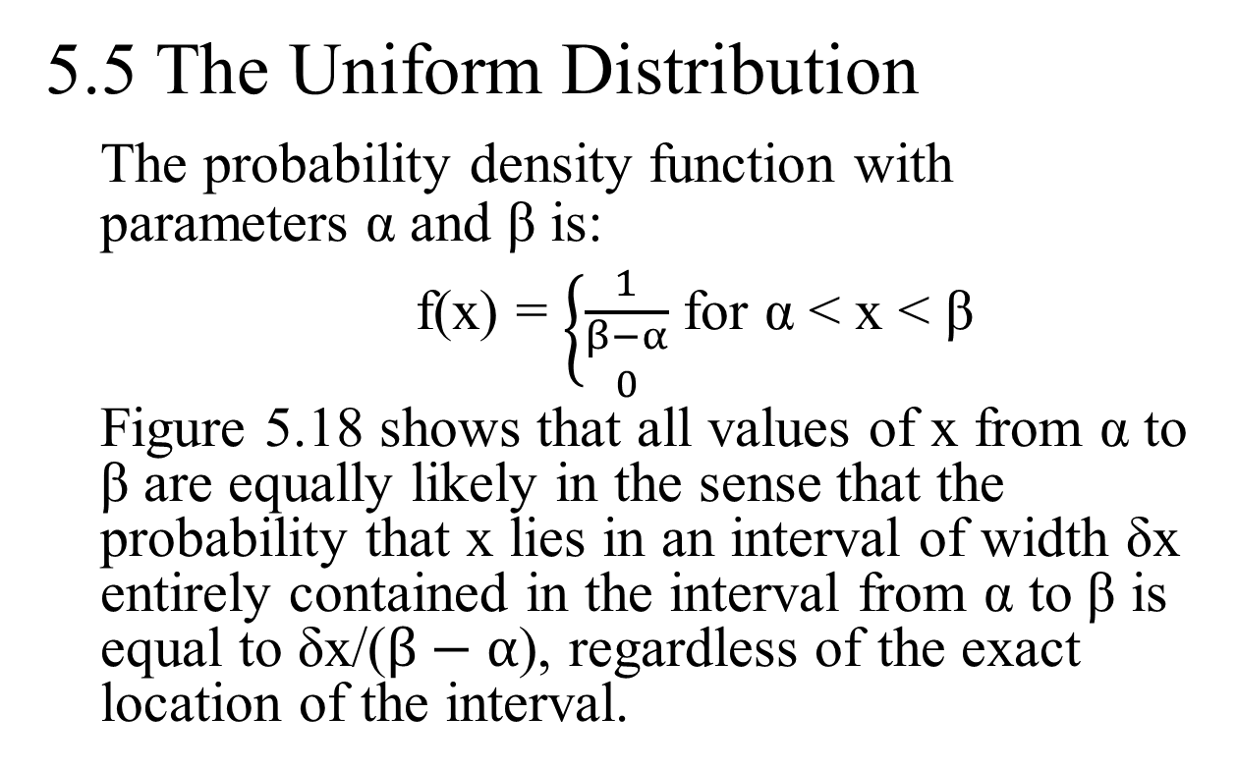
PROBABILITY DENSITIES
5.5 The Uniform Distribution
The probability density function with parameters α and β is:
f(x) = $\left\{\frac{1}{\begin{aligned}β−α \\ 0\end{aligned}}\right.$ for α < x < β
Figure 5.18 shows that all values of x from α to β are equally likely in the sense that the probability that x lies in an interval of width δx entirely contained in the interval from α to β is equal to δx/($β−α$), regardless of the exact location of the interval.

Slide 16
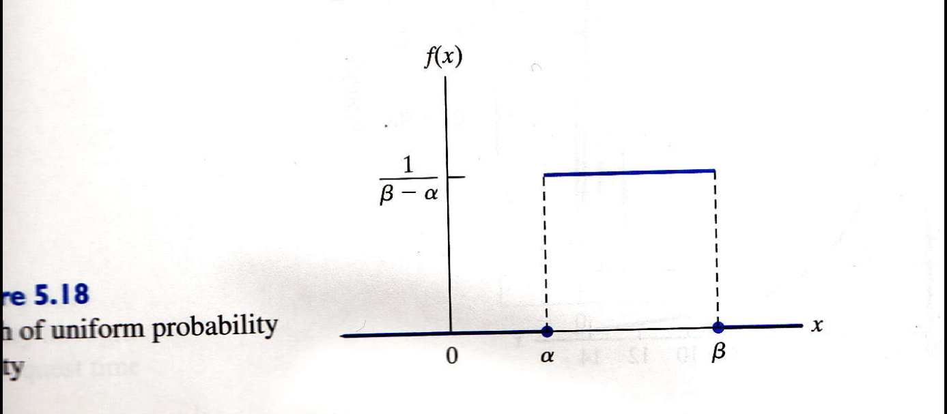
PROBABILITY DENSITIES

Slide 17
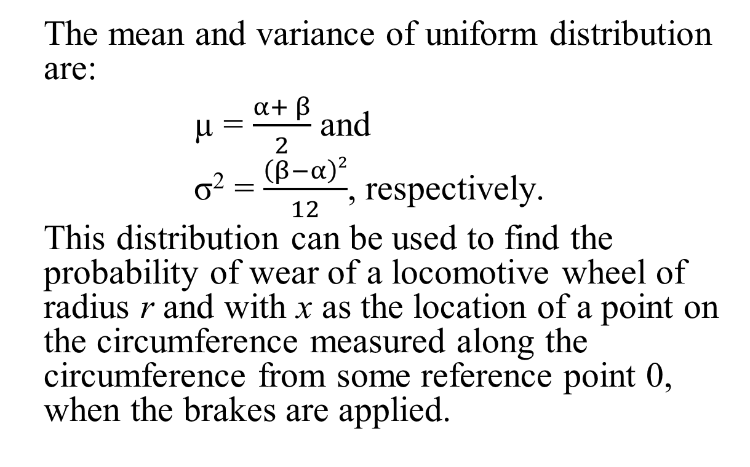
PROBABILITY DENSITIES
The mean and variance of uniform distribution are:
µ = $\frac{α+ β}{2}$ and
σ² = $\frac{\left(β−α\right)2}{12}$, respectively.
This distribution can be used to find the probability of wear of a locomotive wheel of radius r and with x as the location of a point on the circumference measured along the circumference from some reference point 0, when the brakes are applied.

Slide 18
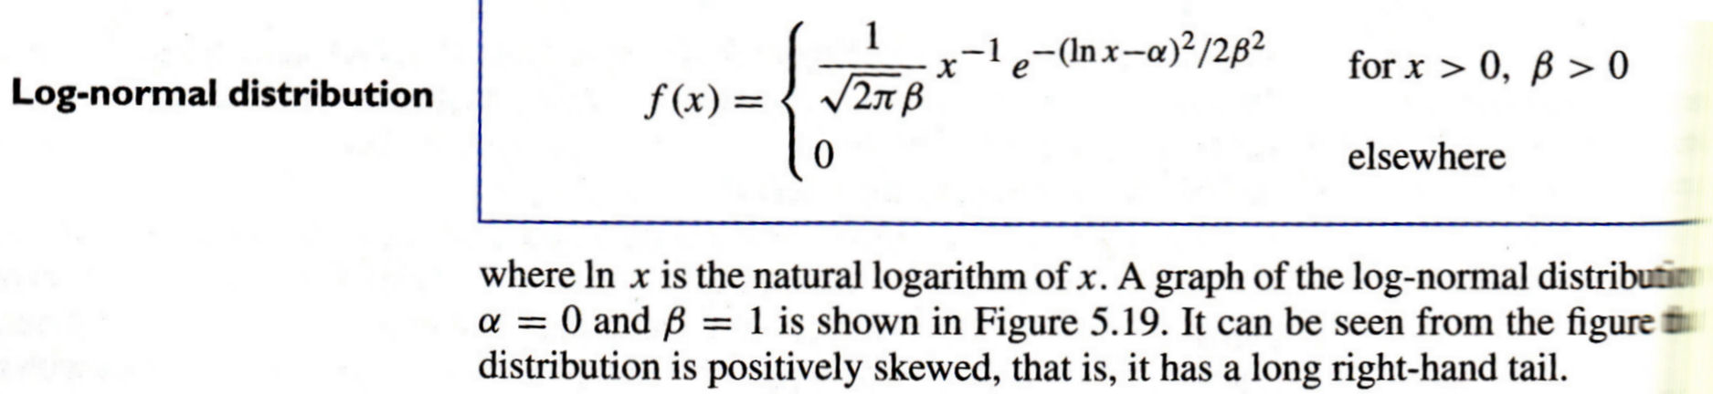
PROBABILITY DENSITIES
5.6 The Log-Normal Distribution
This distribution occurs in practice whenever we encounter a random variable which is such that its logarithm has a normal distribution. The pdf is

Slide 19
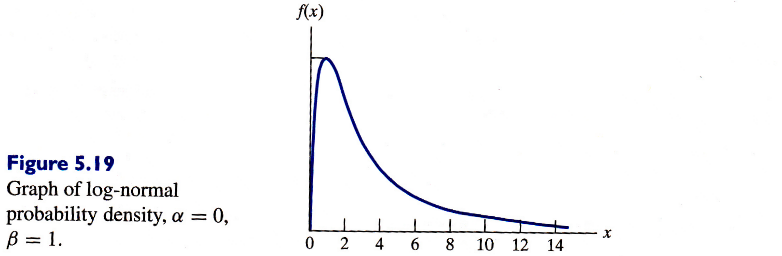
PROBABILITY DENSITIES

Slide 20
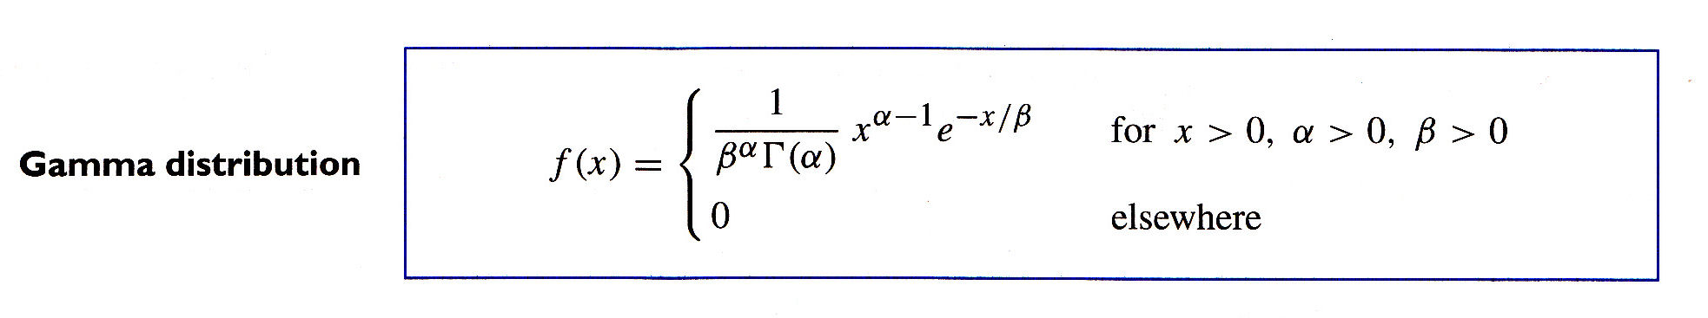
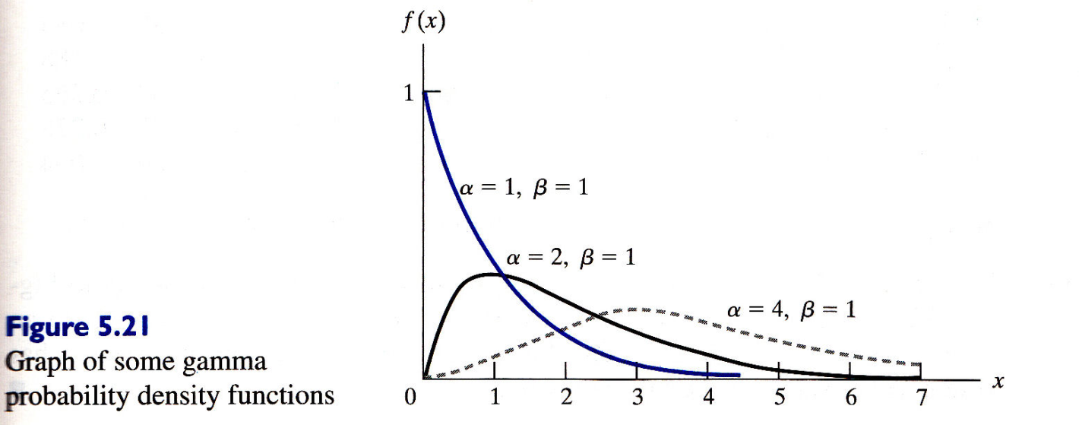
PROBABILITY DENSITIES
5.7 The Gamma Distribution

Slide 21
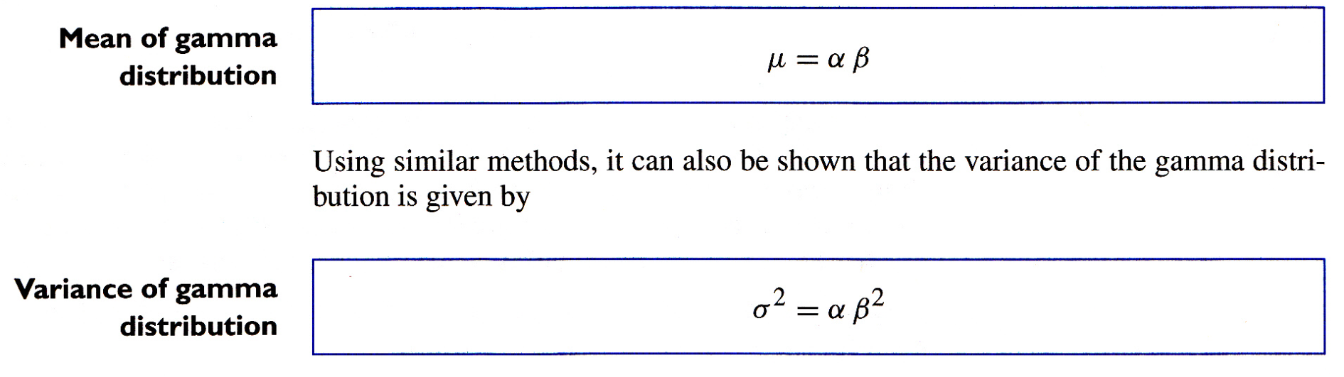
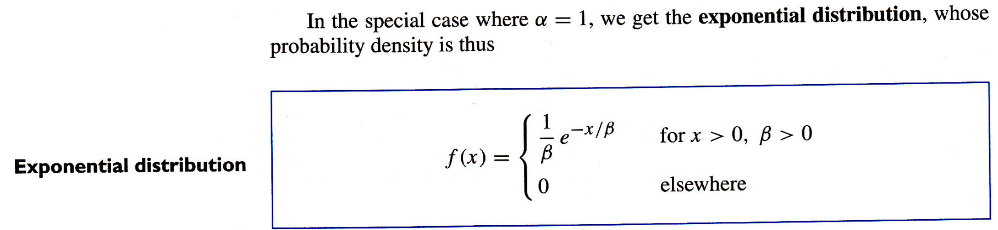
PROBABILITY DENSITIES

Slide 22
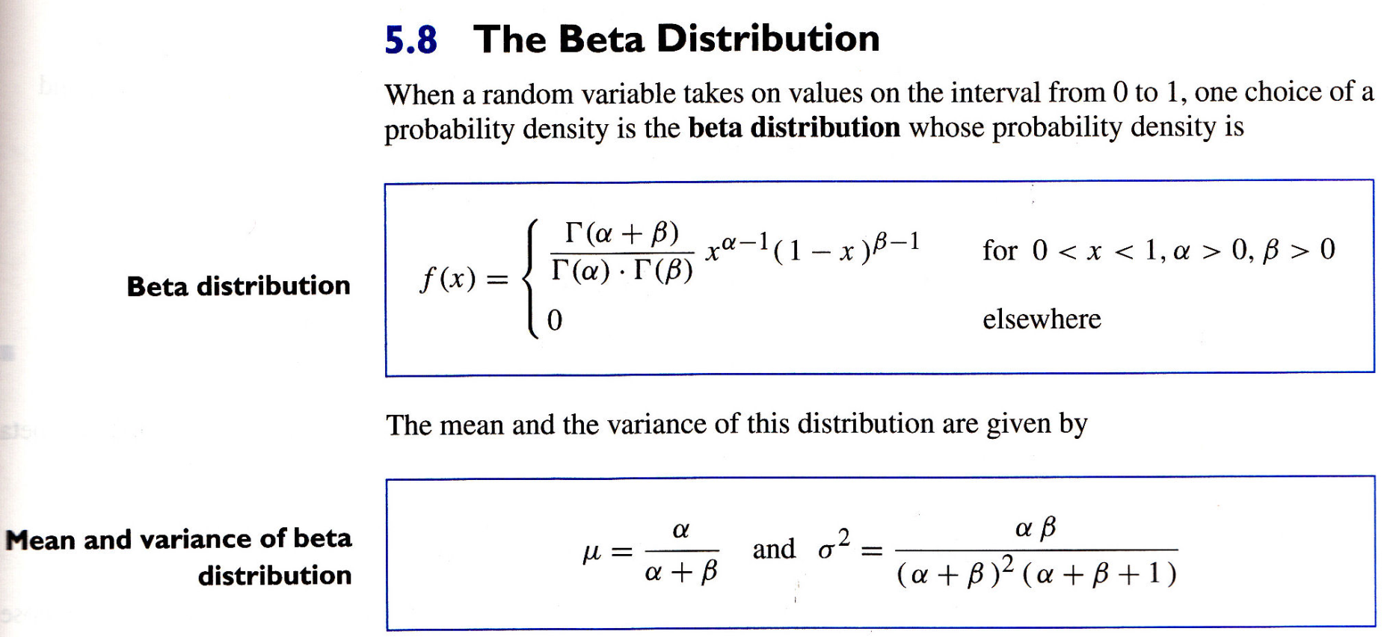
PROBABILITY DENSITIES

Slide 23
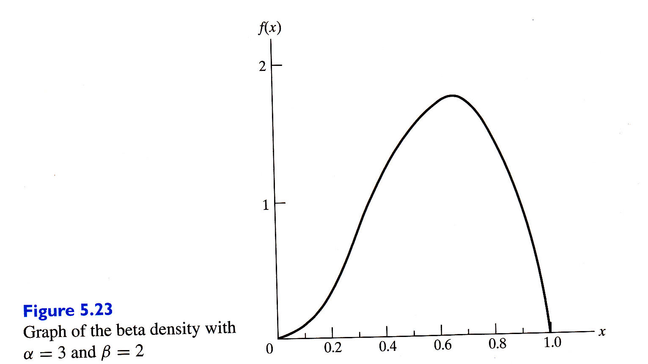
PROBABILITY DENSITIES

Slide 24
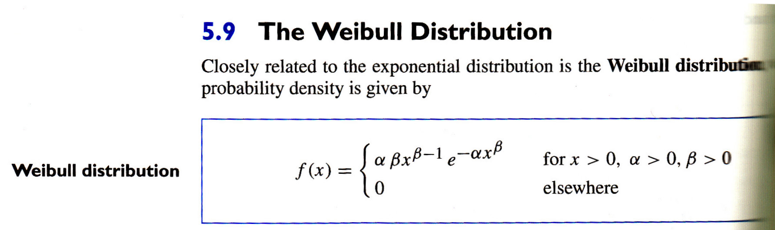
PROBABILITY DENSITIES

Slide 25
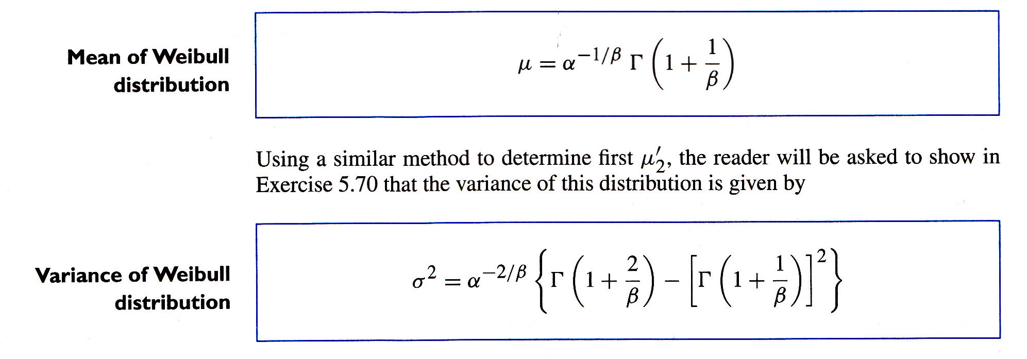
PROBABILITY DENSITIES

Slide 26
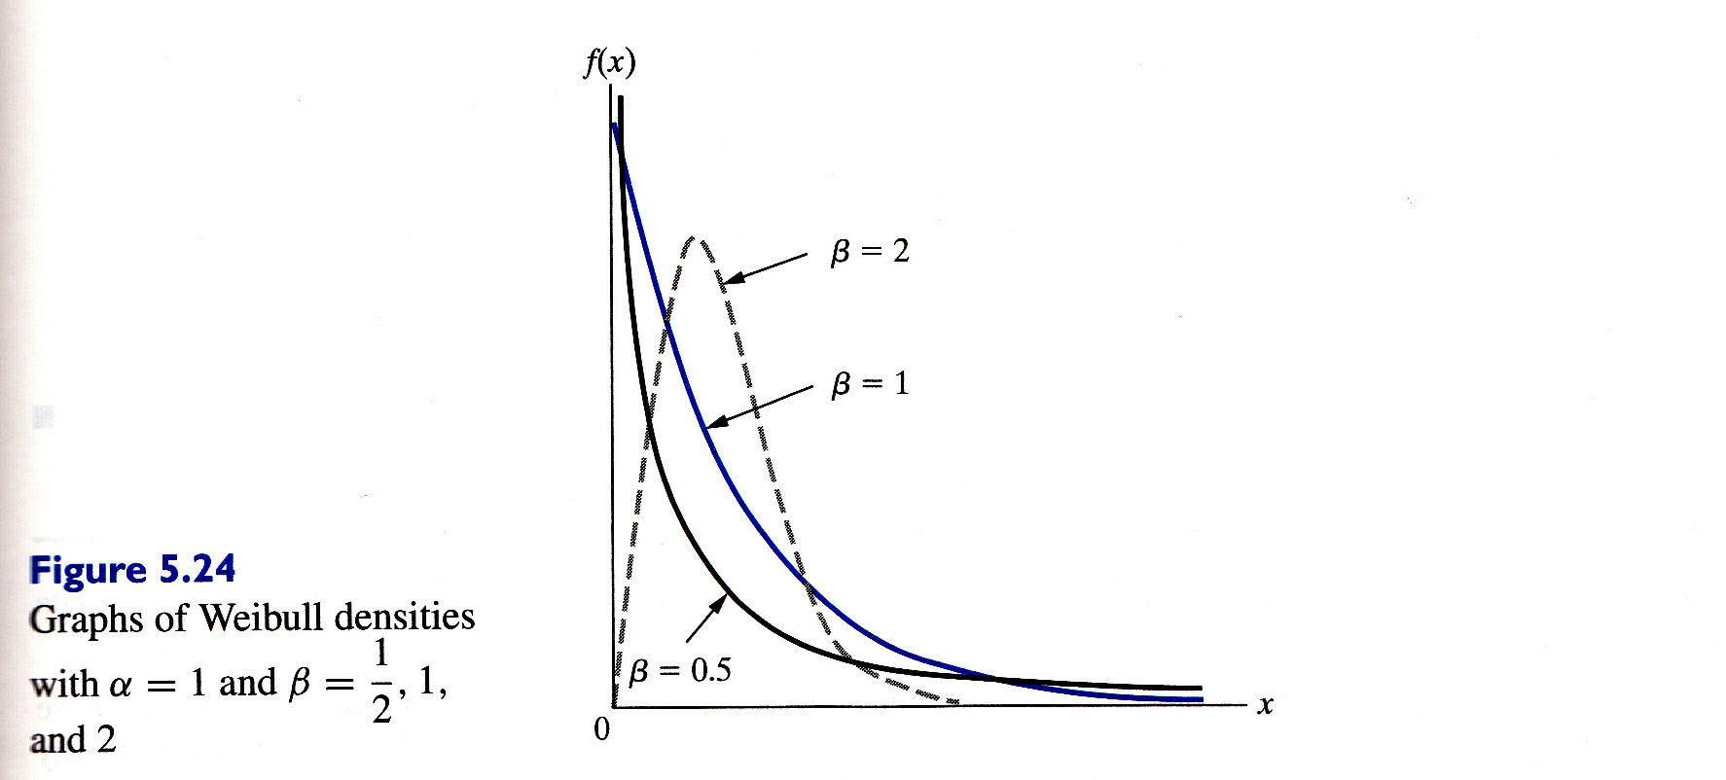
PROBABILITY DENSITIES

Slide 27
PROBABILITY DENSITIES
5.10 Joint Distributions – Discrete and Continuous
Discrete
For two discrete random variables X₁ and X₂, the probability that X₁ takes a value x₁ and X₂ takes a value x₂ is written as
P(X₁ = x₁, X₂ = x₂)
The distribution of probability is specified by listing the probabilities associated with all possible pairs of values x1 and x₂. Thus the joint probability distribution function is given by
f(x₁, x₂) = P(X₁ = x₁, X₂ = x₂)

Slide 28
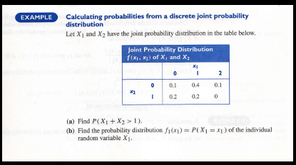
PROBABILITY DENSITIES

Slide 29
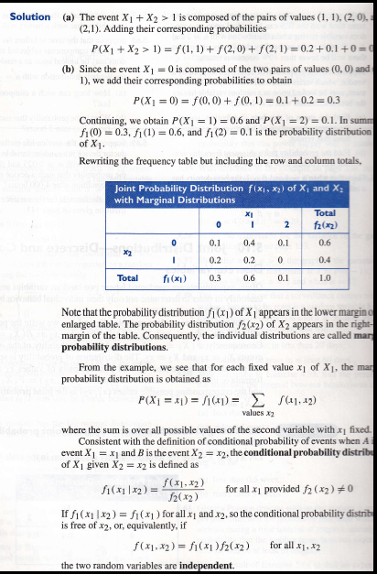
PROBABILITY DENSITIES

Slide 30
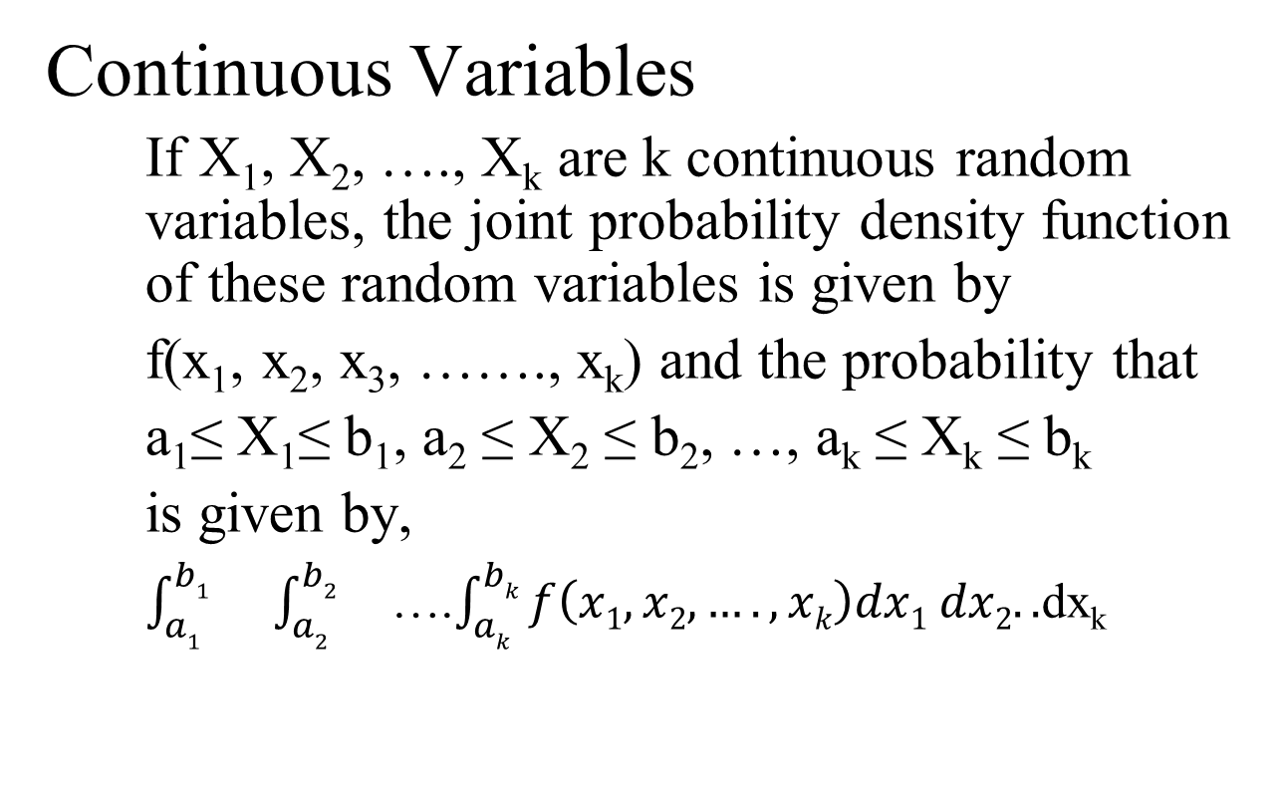
PROBABILITY DENSITIES
Continuous Variables
If X₁, X₂, …., X_{k} are k continuous random variables, the joint probability density function of these random variables is given by
f(x₁, x₂, x₃, ……., x_{k}) and the probability that
a₁≤ X₁≤ b₁, a₂ ≤ X₂ ≤ b₂, …, a_{k} ≤ X_{k} ≤ b_{k}
is given by,
$\int_{a1}^{b1}{}\int_{a2}^{b2}{}$….$\int_{ak}^{bk}{f\left(x1, x2,…., xk\right)dx1 dx2..}$dx_{k}

Slide 31
PROBABILITY DENSITIES
5.11 Moment Generating Functions

Slide 32
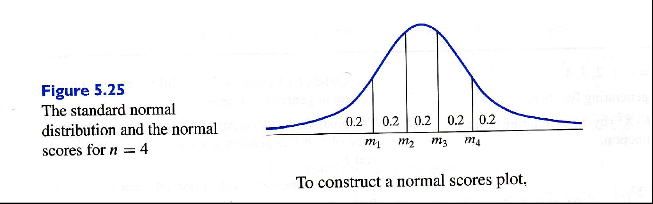
PROBABILITY DENSITIES
5.12 Checking if the Data are Normal

Slide 33
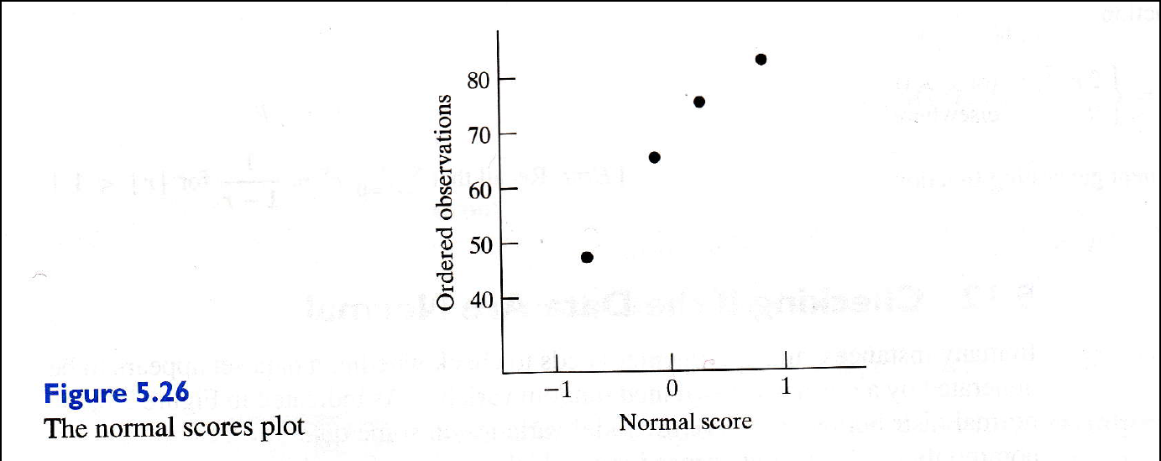
PROBABILITY DENSITIES
5.12 Checking if the Data are Normal

Slide 34
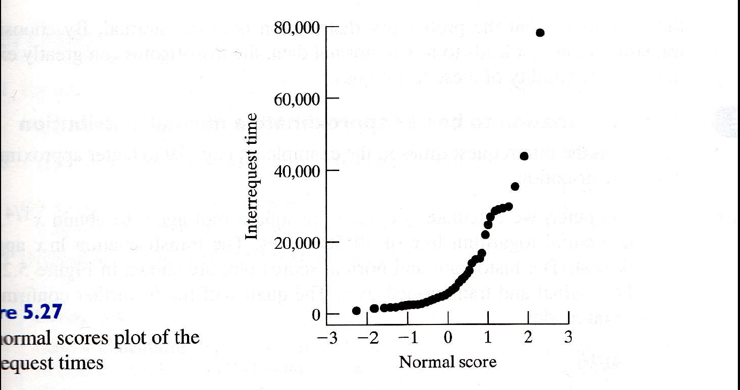
PROBABILITY DENSITIES
5.12 Checking if the Data are Normal

Slide 35
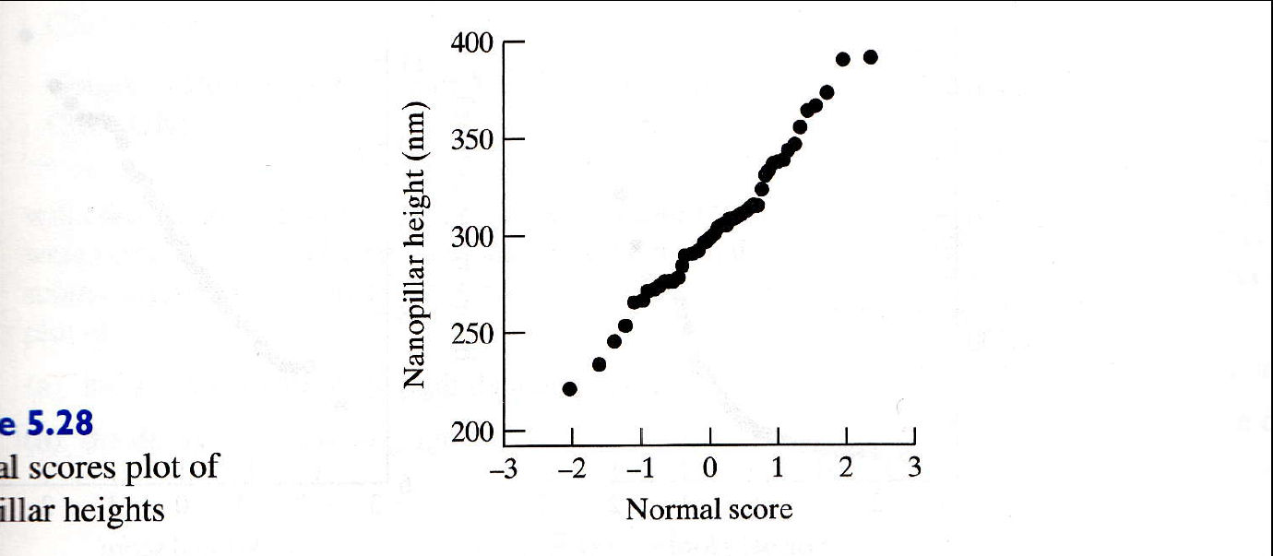
PROBABILITY DENSITIES
5.12 Checking if the Data are Normal

Slide 36
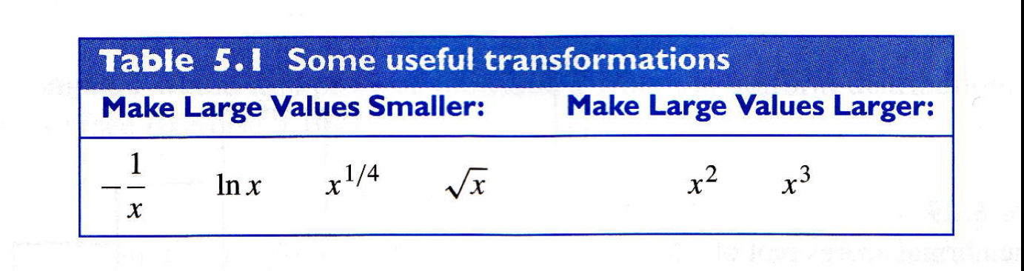
PROBABILITY DENSITIES
5.13 Transforming Observations to Near Normality

Slide 37
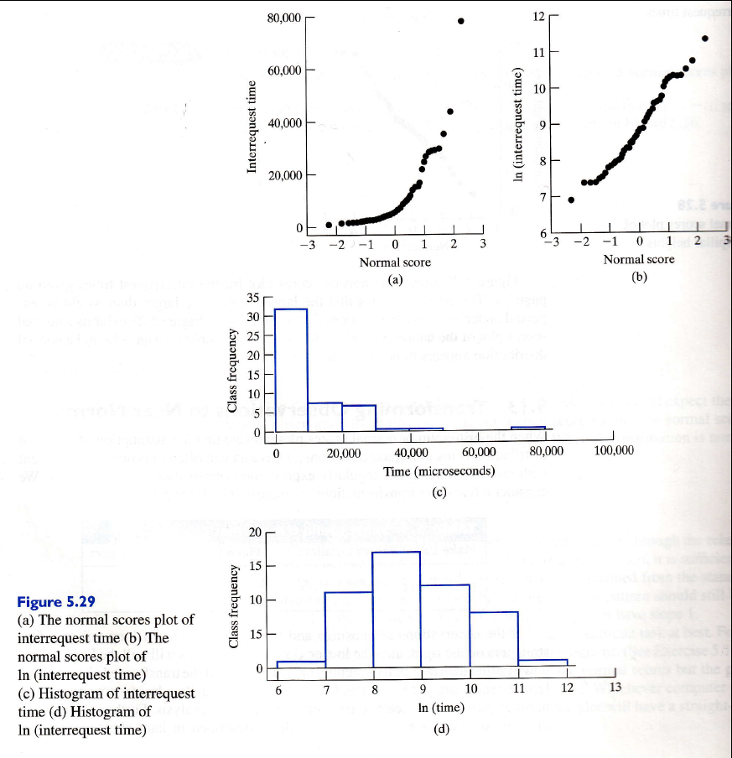
PROBABILITY DENSITIES
5.13 Transforming Observations to Near Normality

Slide 38
PROBABILITY DENSITIES
5.14 Simulation

