Slide 1
PROBABILITY AND STATISTICS FOR ENGINEERS - I
Chapter 4
PROBABILITY DISTRIBUTIONS

Slide 2
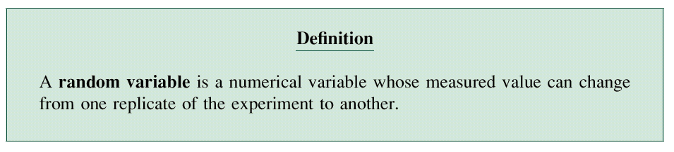
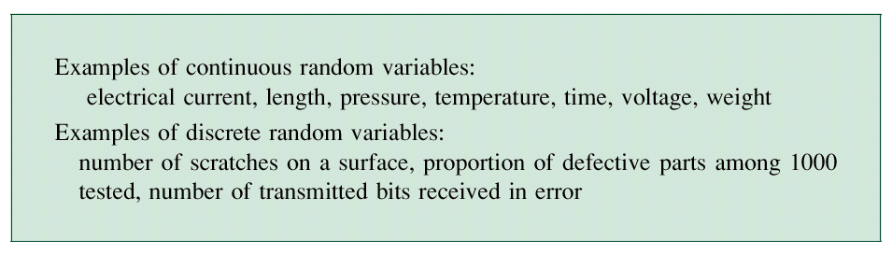
PROBABILITY DISTRIBUTIONS
4.1 Random Variables

Slide 3
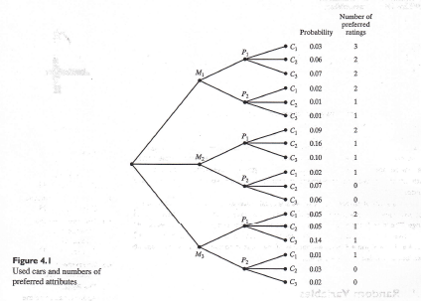
PROBABILITY DISTRIBUTIONS

Slide 4
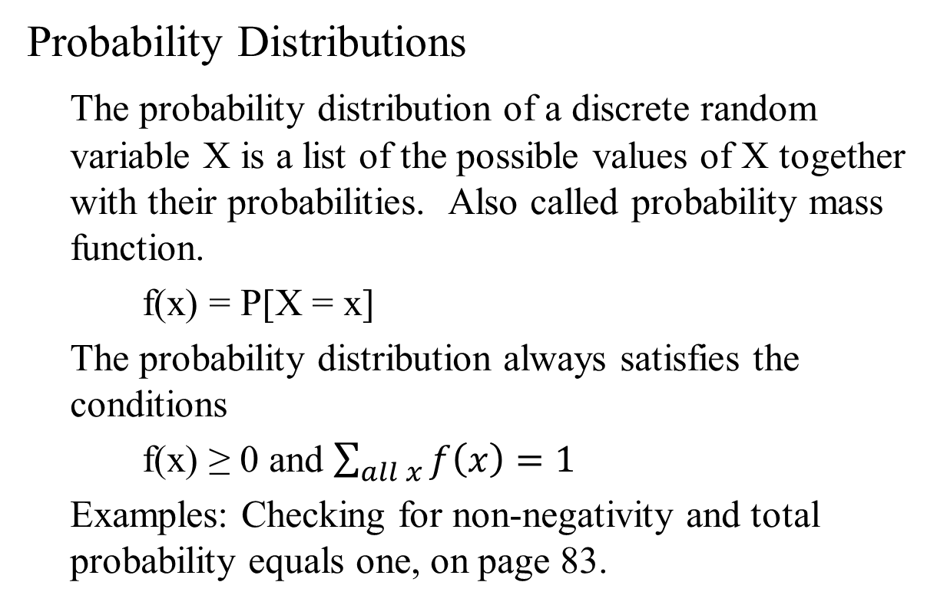
PROBABILITY DISTRIBUTIONS
Probability Distributions
The probability distribution of a discrete random variable X is a list of the possible values of X together with their probabilities. Also called probability mass function.
f(x) = P[X = x]
The probability distribution always satisfies the conditions
f(x) ≥ 0 and $\sum_{all x}{f\left(x\right)=1}$
Examples: Checking for non-negativity and total probability equals one, on page 83.

Slide 5
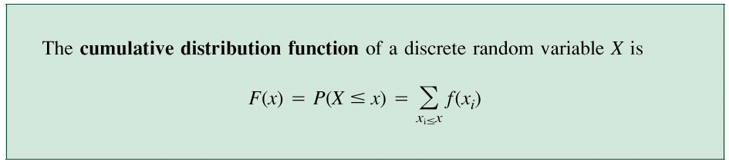
PROBABILITY DISTRIBUTIONS
Cumulative Distribution Functions

Slide 6
PROBABILITY DISTRIBUTIONS
4.2 Binomial Distribution
Bernoulli’s trials. The assumptions are:
    There are only two possible outcomes for each trial (arbitrarily called “success” and “failure,” without inferring that a success is necessarily desirable).
    The probability of success is the same for each trial
    The outcomes from each trial are independent
    There are a fixed number n of Bernoulli trials conducted
Examples: Checking the adequacy of the Bernoulli trials assumptions, and Binomial probability distribution n = 3, page 85-86.

Slide 7
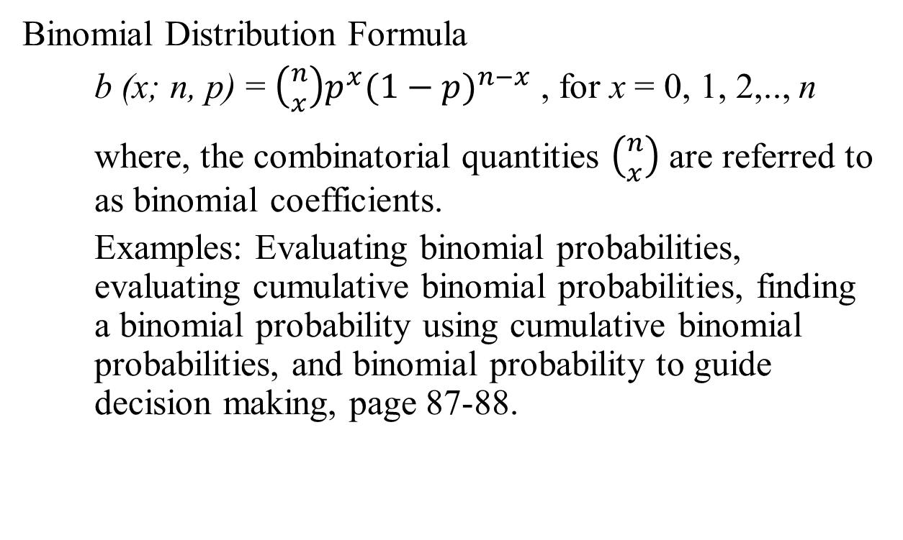
PROBABILITY DISTRIBUTIONS
Binomial Distribution Formula
b (x; n, p) = $\left({n \atop x}\right)p^{x}{(1−p)}^{n−x}$ , for x = 0, 1, 2,.., n
where, the combinatorial quantities $\left({n \atop x}\right)$ are referred to as binomial coefficients.
Examples: Evaluating binomial probabilities, evaluating cumulative binomial probabilities, finding a binomial probability using cumulative binomial probabilities, and binomial probability to guide decision making, page 87-88.

Slide 8
PROBABILITY DISTRIBUTIONS
4.3 The Hyper-geometric Distribution
If we are interested in the number of defectives in a sample of n units drawn without replacement from a lot containing N units, of which a are defective, then this distribution is helpful.
The probability that the first drawing will yield a defective = a/N
However, the probability of getting a defective in the second drawing = (a-1)/(N-1) or a/(N-1) depending on whether or not the first unit drawn was defective.

Slide 9
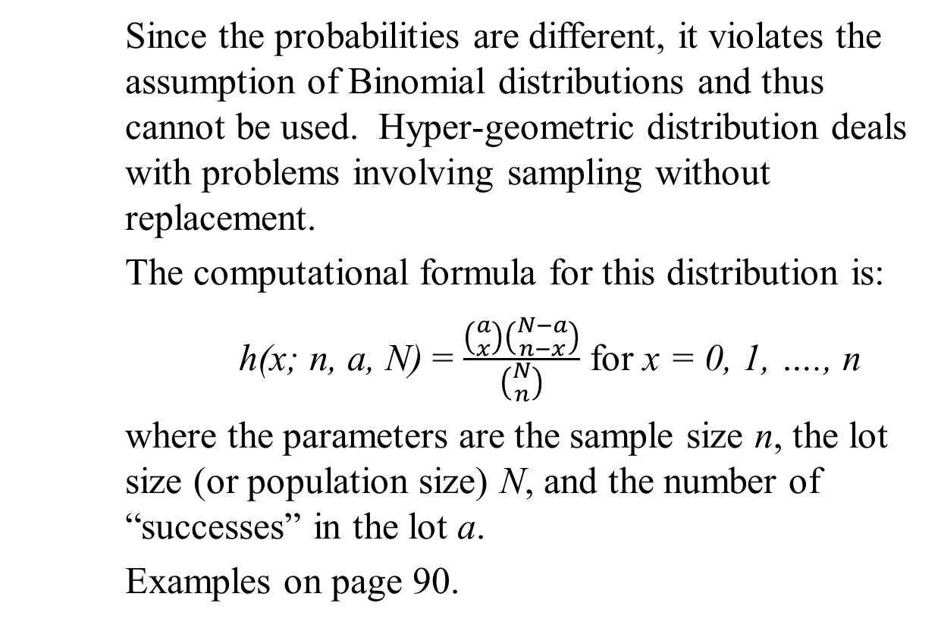
PROBABILITY DISTRIBUTIONS
Since the probabilities are different, it violates the assumption of Binomial distributions and thus cannot be used. Hyper-geometric distribution deals with problems involving sampling without replacement.
The computational formula for this distribution is:
h(x; n, a, N) = $\frac{\left({a \atop x}\right)\left({N−a \atop n−x}\right)}{\left({N \atop n}\right)}$ for x = 0, 1, …., n
where the parameters are the sample size n, the lot size (or population size) N, and the number of “successes” in the lot a.
Examples on page 90.

Slide 10
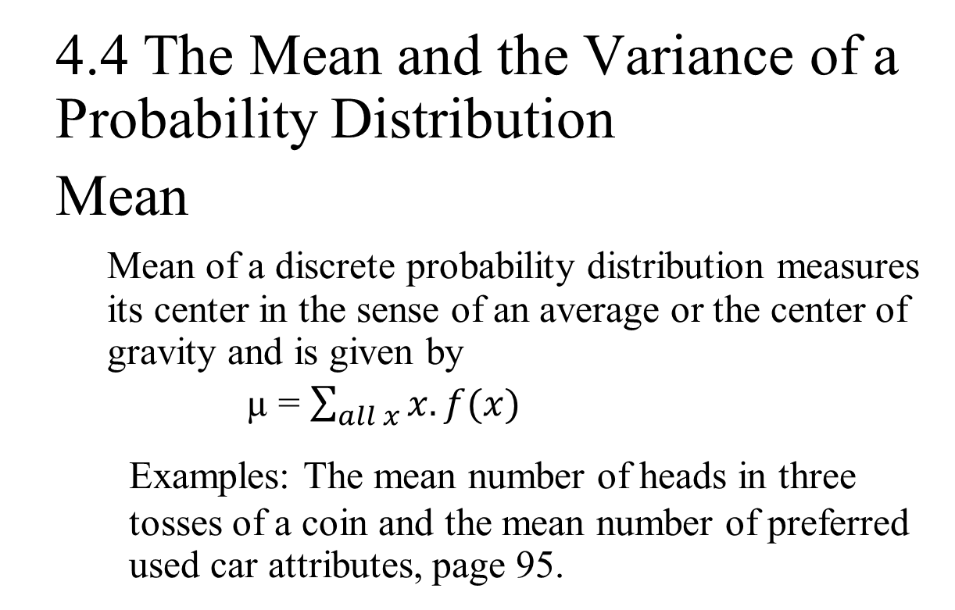
PROBABILITY DISTRIBUTIONS
4.4 The Mean and the Variance of a Probability Distribution
Mean
  Mean of a discrete probability distribution measures its center in the sense of an average or the center of gravity and is given by
µ = $\sum_{all x}{x.f(x)}$
Examples: The mean number of heads in three tosses of a coin and the mean number of preferred used car attributes, page 95.

Slide 11
PROBABILITY DISTRIBUTIONS
Mean of Binomial distribution
µ = n.p
where n and p are sample size and the probability of success, respectively
Mean of hyper-geometric distribution
µ = n.a/N
where n, a, and N are the parameters of the distribution.
Example on page 96.

Slide 12
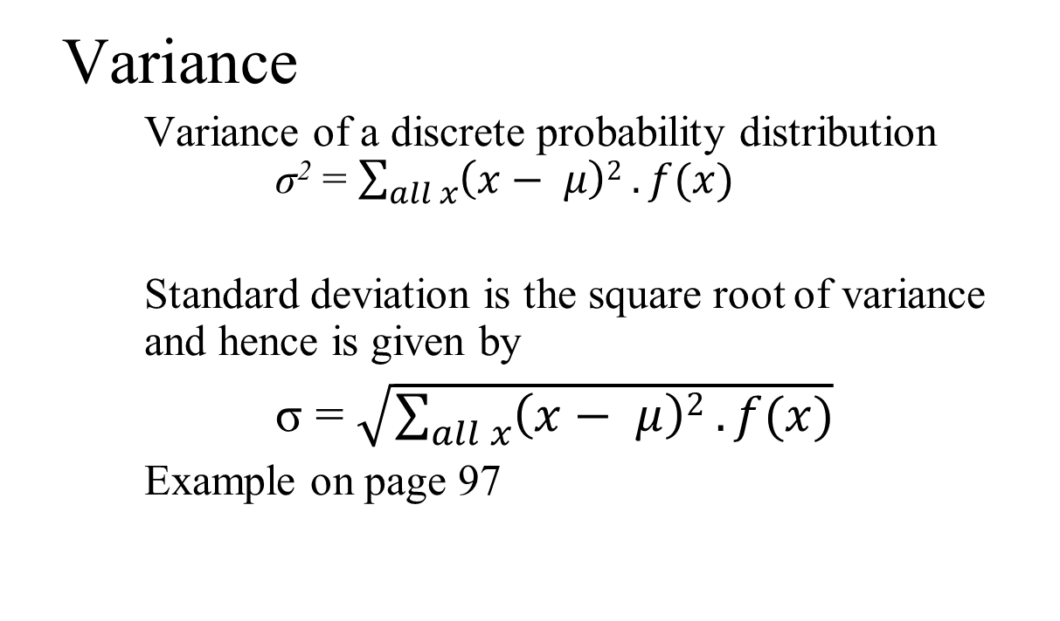
PROBABILITY DISTRIBUTIONS
Variance
Variance of a discrete probability distribution σ² = $\sum_{all x}{\left(x− μ\right)2 . f(x)}$
Standard deviation is the square root of variance and hence is given by
σ = $\sqrt{\sum_{all x}{\left(x− μ\right)2 . f(x)}}$
Example on page 97

Slide 13
PROBABILITY DISTRIBUTIONS
Variance of binomial distribution
σ² = n . p . (1 – p)
Example on page 98
Variance of binomial distribution
σ² = n . a/N . (1–a/N)((N-n)/(N-1))
Example on page 98

Slide 14
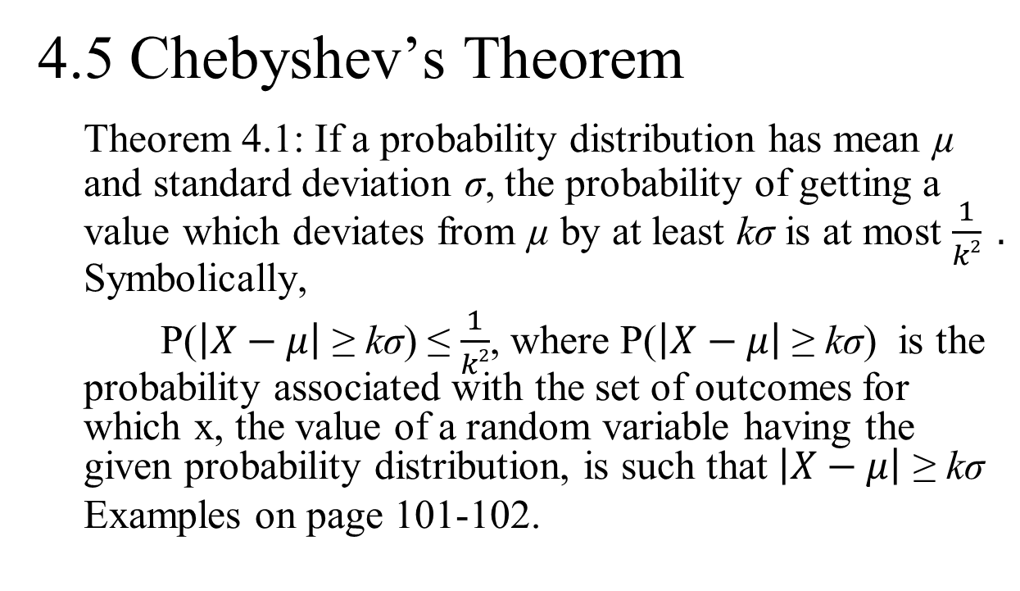
PROBABILITY DISTRIBUTIONS
4.5 Chebyshev’s Theorem
Theorem 4.1: If a probability distribution has mean µ and standard deviation σ, the probability of getting a value which deviates from µ by at least kσ is at most $\frac{1}{k2} .$ Symbolically,
P($\left|X−μ\right|$ ≥ kσ) ≤ $\frac{1}{k2}$, where P($\left|X−μ\right|$ ≥ kσ) is the probability associated with the set of outcomes for which x, the value of a random variable having the given probability distribution, is such that $\left|X−μ\right|$ ≥ kσ
Examples on page 101-102.

Slide 15
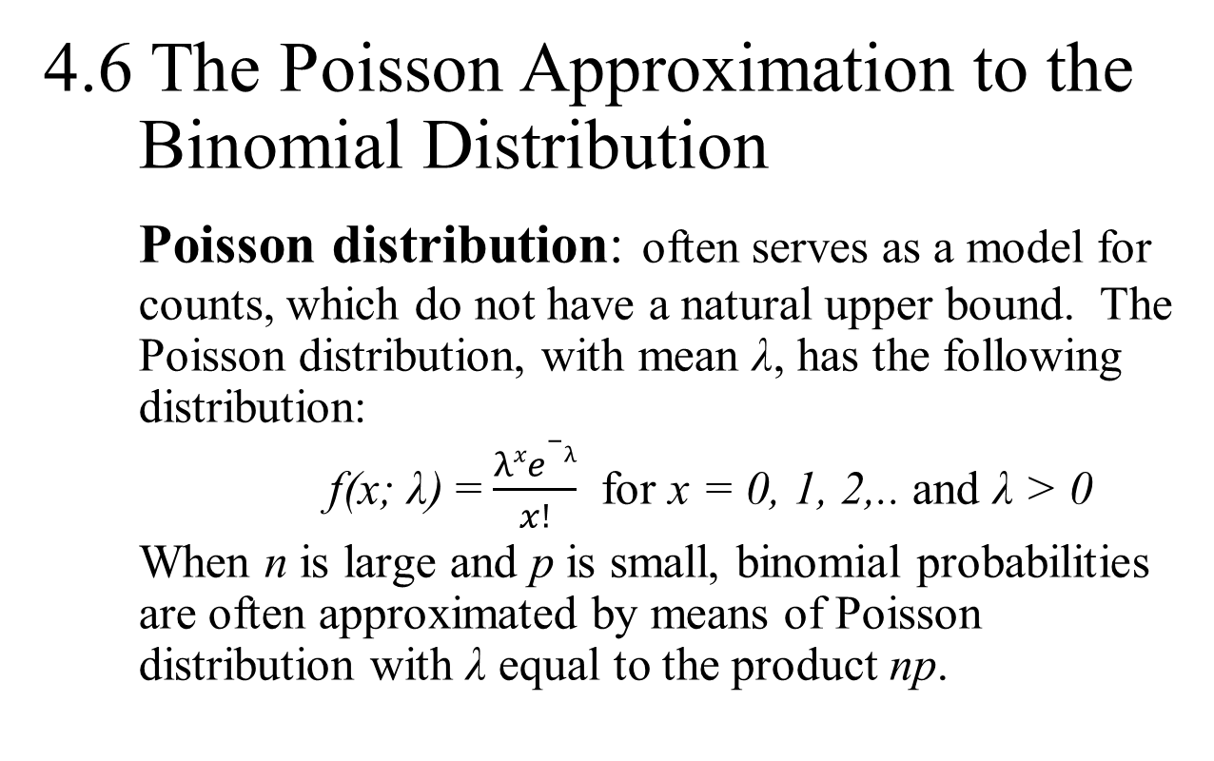
PROBABILITY DISTRIBUTIONS
4.6 The Poisson Approximation to the Binomial Distribution
Poisson distribution: often serves as a model for counts, which do not have a natural upper bound. The Poisson distribution, with mean λ, has the following distribution:
f(x; λ) = $\frac{λxe−λ}{x!}$ for x = 0, 1, 2,.. and λ > 0
When n is large and p is small, binomial probabilities are often approximated by means of Poisson distribution with λ equal to the product np.

Slide 16
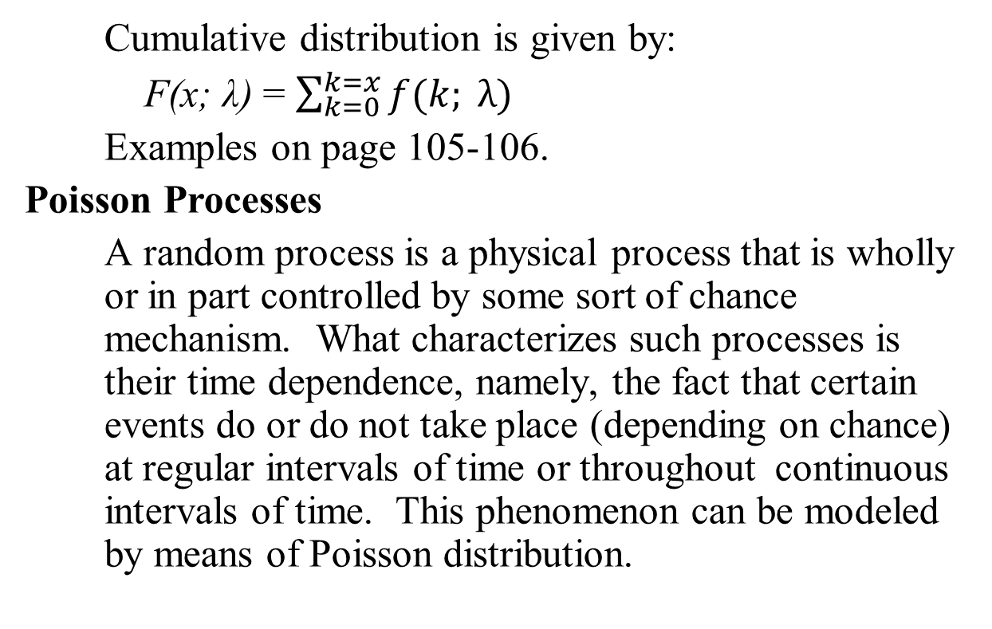
PROBABILITY DISTRIBUTIONS
Cumulative distribution is given by:
F(x; λ) = $\sum_{k=0}^{k=x}{f(k; λ)}$
Examples on page 105-106.
Poisson Processes
A random process is a physical process that is wholly or in part controlled by some sort of chance mechanism. What characterizes such processes is their time dependence, namely, the fact that certain events do or do not take place (depending on chance) at regular intervals of time or throughout continuous intervals of time. This phenomenon can be modeled by means of Poisson distribution.

Slide 17
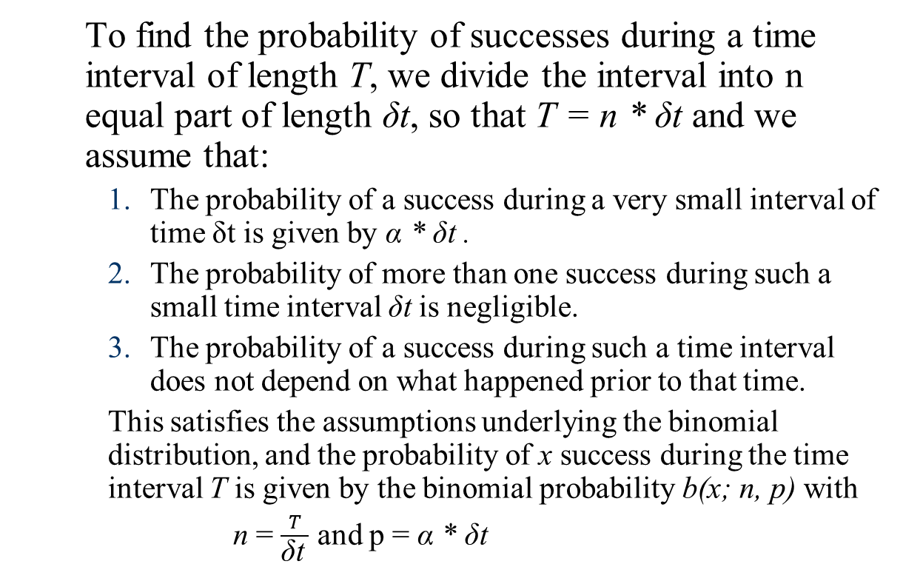
PROBABILITY DISTRIBUTIONS
To find the probability of successes during a time interval of length T, we divide the interval into n equal part of length δt, so that T = n * δt and we assume that:
    The probability of a success during a very small interval of time δt is given by α * δt .
    The probability of more than one success during such a small time interval δt is negligible.
    The probability of a success during such a time interval does not depend on what happened prior to that time.
    This satisfies the assumptions underlying the binomial distribution, and the probability of x success during the time interval T is given by the binomial probability b(x; n, p) with
    n = $\frac{T}{\text{δ}\text{t} }$ and p = α * δt

Slide 18
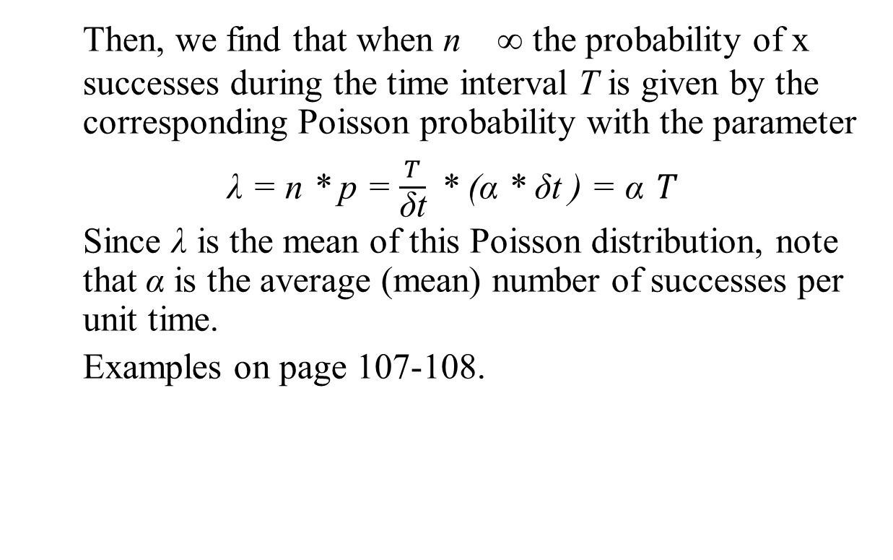
PROBABILITY DISTRIBUTIONS
Then, we find that when n ∞ the probability of x successes during the time interval T is given by the corresponding Poisson probability with the parameter
λ = n * p = $\frac{T}{\text{δ}\text{t}}$ * (α * δt ) = α $T$
Since λ is the mean of this Poisson distribution, note that α is the average (mean) number of successes per unit time.
Examples on page 107-108.

Slide 19
PROBABILITY DISTRIBUTIONS
4.8 The Geometric and Negative Binomial Distribution
Sometimes we may be interested in finding out the number of trials until the first success occurs. In this case, all the three assumptions of Bernoulli trials are fulfilled. However, the fourth assumption that the number of trial needed to be fixed, is not fulfilled, i.e., in this case the number of trials is not fixed. Thus, if the first success comes in the x^{th} trial, there have to be (x-1) failures before that. If p is the probability of success, then probability of (x-1) failures in (x-1) trials will be (1-p)^{x-1}

Slide 20
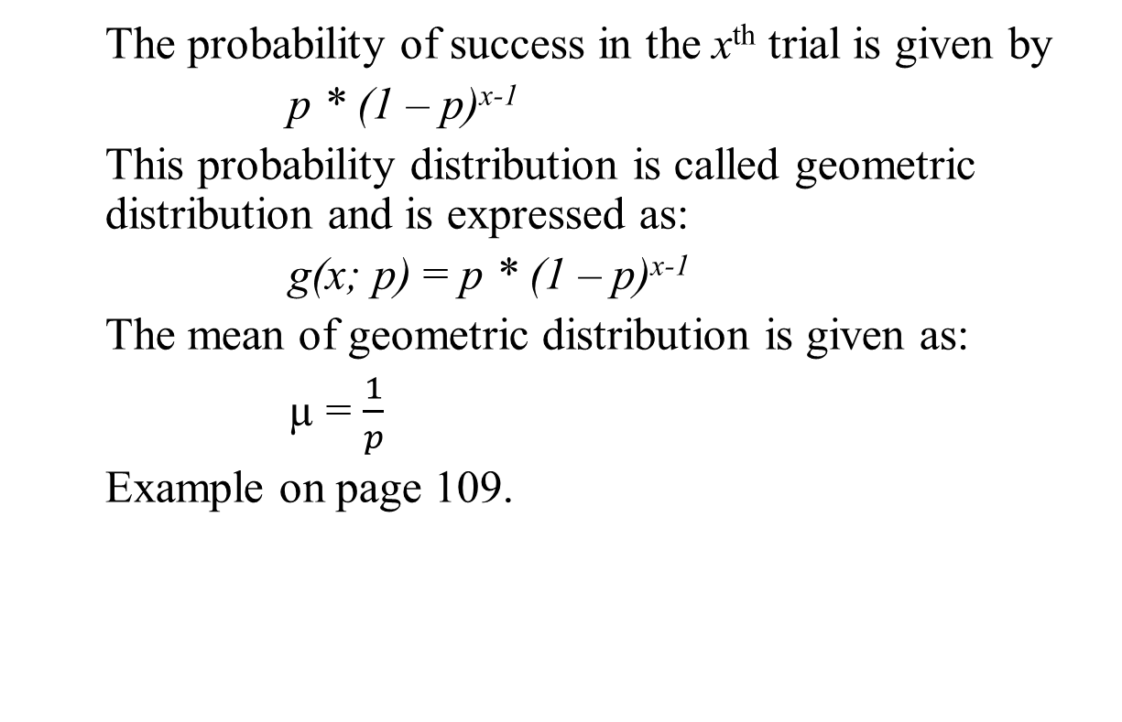
PROBABILITY DISTRIBUTIONS
The probability of success in the x^{th} trial is given by
p * (1 – p)^{x-1}
This probability distribution is called geometric distribution and is expressed as:
g(x; p) = p * (1 – p)^{x-1}
The mean of geometric distribution is given as:
µ = $\frac{1}{p}$
Example on page 109.

Slide 21
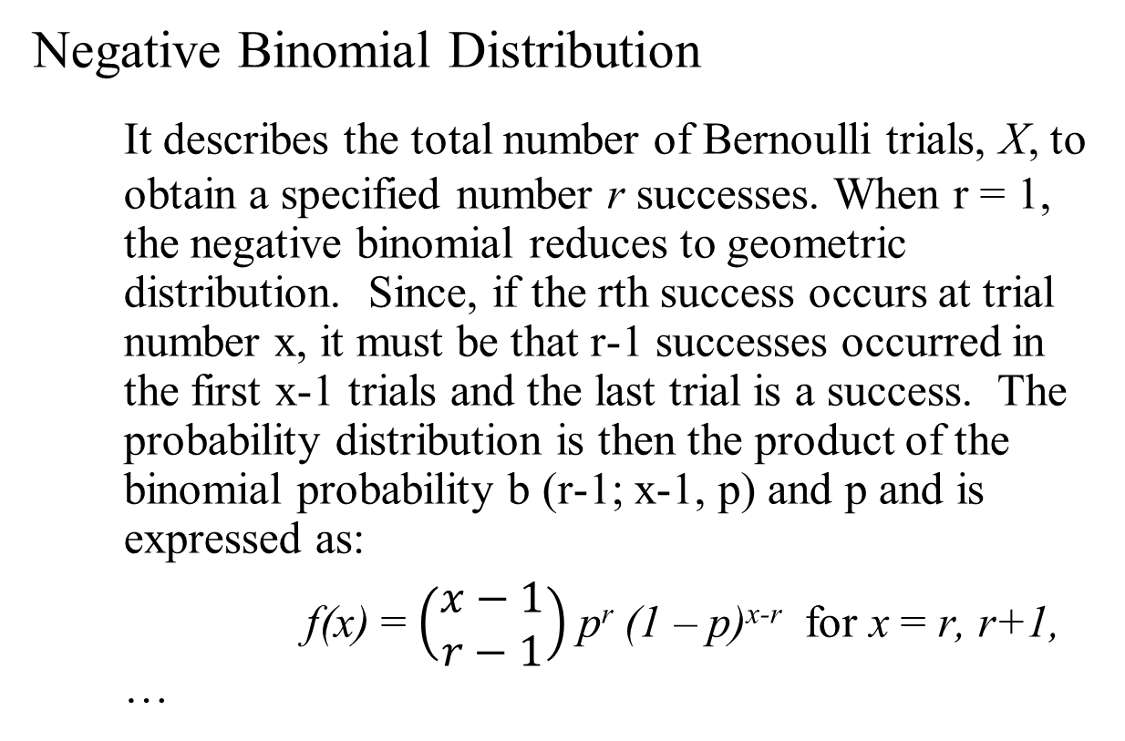
PROBABILITY DISTRIBUTIONS
Negative Binomial Distribution
It describes the total number of Bernoulli trials, X, to obtain a specified number r successes. When r = 1, the negative binomial reduces to geometric distribution. Since, if the rth success occurs at trial number x, it must be that r-1 successes occurred in the first x-1 trials and the last trial is a success. The probability distribution is then the product of the binomial probability b (r-1; x-1, p) and p and is expressed as:
f(x) = $\left(\begin{aligned}x−1 \\ r−1\end{aligned}\right)$ p^{r} (1 – p)^{x-r} for x = r, r+1, …

Slide 22
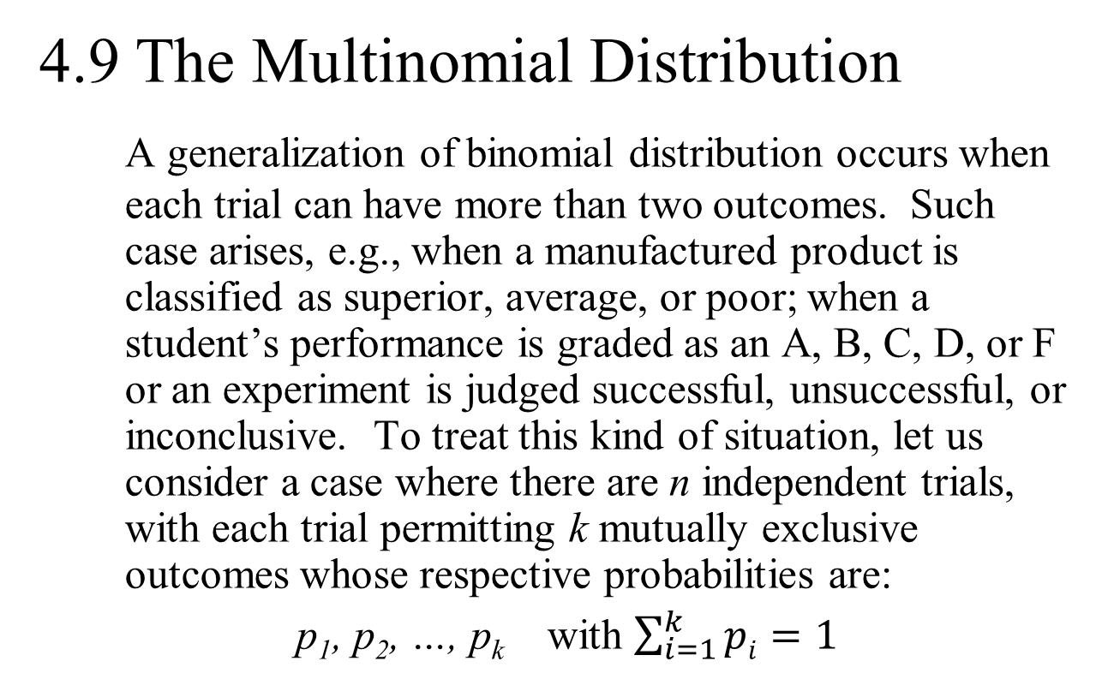
PROBABILITY DISTRIBUTIONS
4.9 The Multinomial Distribution
A generalization of binomial distribution occurs when each trial can have more than two outcomes. Such case arises, e.g., when a manufactured product is classified as superior, average, or poor; when a student’s performance is graded as an A, B, C, D, or F or an experiment is judged successful, unsuccessful, or inconclusive. To treat this kind of situation, let us consider a case where there are n independent trials, with each trial permitting k mutually exclusive outcomes whose respective probabilities are:
p₁, p₂, …, p_{k} with $\sum_{i=1}^{k}{pi=1}$

Slide 23
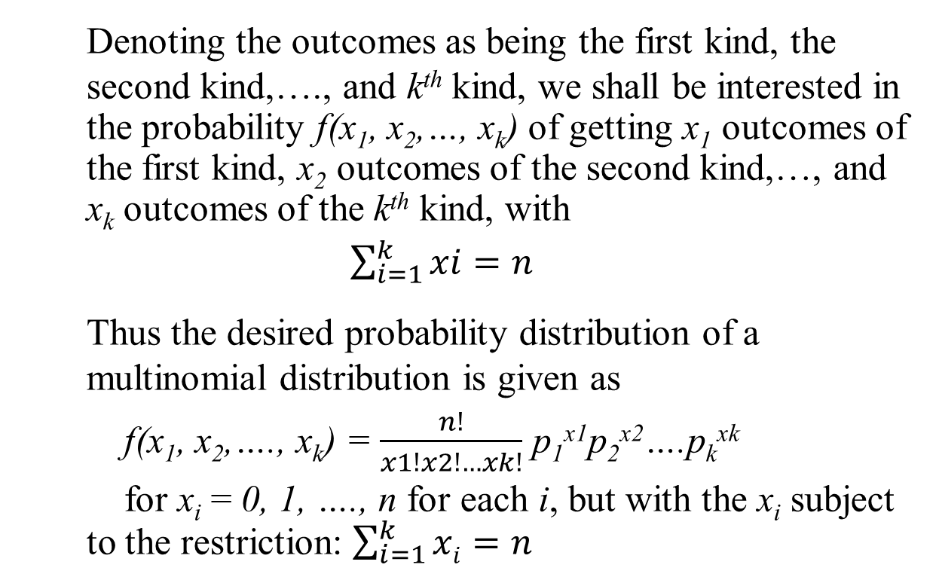
PROBABILITY DISTRIBUTIONS
Denoting the outcomes as being the first kind, the second kind,…., and k^{th} kind, we shall be interested in the probability f(x₁, x₂,…, x_{k}) of getting x₁ outcomes of the first kind, x₂ outcomes of the second kind,…, and x_{k} outcomes of the k^{th} kind, with
$\sum_{i=1}^{k}{xi=n}$
Thus the desired probability distribution of a multinomial distribution is given as
f(x₁, x₂,…., x_{k}) = $\frac{n!}{x1!x2!…xk!}$ p₁^{x1}p₂^{x2}….p_{k}^{xk}
for x_{i} = 0, 1, …., n for each i, but with the x_{i} subject to the restriction: $\sum_{i=1}^{k}{xi=n}$

Slide 24
PROBABILITY DISTRIBUTIONS
4.10 Simulation

