Slide 1
PROBABILITY AND STATISTICS FOR ENGINEERS - I
Chapter 3
PROBABILITY

Slide 2
PROBABILITY
3.1 Sample Spaces and Events
Sample space: a set of all possible outcomes, usually denoted by S.
Examples:
1. If four contractors bid on a highway construction job and if a, b, c, and d denote that it is awarded to Mr. Adam, Mrs. Brown, Mr. Clark, or Ms. Dean, then sample space for this experiment is the set,
S = {a, b, c, d}
2. If govt. agency must decide where to locate two new computer research facilities between Texas and CA, the sample space can be ,
S = {(0,0), (1,0), (0,1), (2,0), (1,1), (0,2)}

Slide 3
PROBABILITY
Finite sample space: when the sample space contains finite number of elements, as shown in the previous examples.
Infinite sample space: when the sample space contains elements which are not finite.
Example: if a person is checking nitrogen-oxide emission of cars and is interested in finding the first car that violates the set standard, then the person could achieve that in the first car or second car or might have to go on for ever.
Discrete sample space: when the sample space contains finitely many or countable infinite number of elements.
Continuous sample space: if the elements of the sample space constitute a continuum, such as the points on a line.

Slide 4
PROBABILITY
Event: any subset of sample space.
Example: in the example of computer research facility given above,
C = {(1,0), (0,1)}
is the event that between the two states, Texas and CA will get one facility each.
D = {(0,0), (0,1), (0,2)}
is the event that Texas will not get either of the two research facility, and
E = {(0,0), (1,1)}
is the event that each state will get equal number.

Slide 5
PROBABILITY
Mutually exclusive events: events that do not have any element in common.
Example: In the above example, events C and E are mutually exclusive because they have no elements in common.
Union of events: if A and B are two events, then their union is an event which contains all elements of A or B or both. It is denoted by A U B

Slide 6
PROBABILITY
Intersection of events: if A and B are two events, then their intersection is an event which contains elements that are common to both A and B. It is denoted by
A ∩ B.
Complement of an event: If A is an event, then its complementary is an event which does not contain any element of A.
Using Venn diagram to represent the above interactions between the events.

Slide 7
PROBABILITY
Example:
With reference to the sample space (computer research facilities) given above, list the outcomes comprising each of the following events:
a. C U E;
b. C ∩ D;
c. D

Slide 8
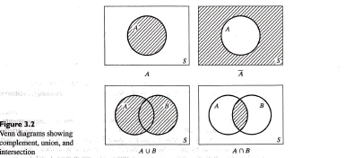
PROBABILITY

Slide 9
PROBABILITY
3.2 Counting
It becomes difficult to determine the number of elements in a finite sample space by direct enumeration. Example of used cars in a large city. Cars can be classified as low, medium, or high mileage (M₁, M₂, or M₃); moderate or high priced (P₁ or P₂); and be inexpensive, average, or expensive to operate (C₁, C₂, or C₃); giving a number of ways a used car can be classified. Figure 3.5, page 50.

Slide 10
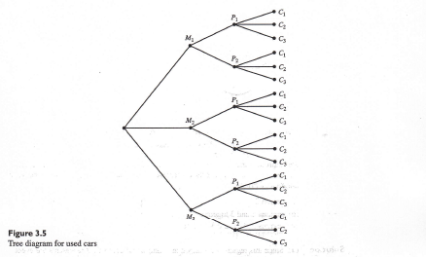
PROBABILITY

Slide 11
PROBABILITY
Multiplication of choices
Theorem 3.1: If sets A₁, A₂,……, A_{k} contain, respectively, n₁, n₂, ……, n_{k} elements, there are n₁.n₂…..n_{k} ways of choosing first an element of A₁, then an element of A₂, …., and finally an element of A_{k}.
Examples: the multiplication rule for k = 2 stages of choices, k = 12 stages of choices, and determining the size of an experiment, page 50-51.

Slide 12
PROBABILITY
Permutations
Often, we want to count all of the possible ways that a single set of objects can be arranged. For example, consider the letters X, Y, and Z. These letters can be arranged a number of different ways (XYZ, XZY, YXZ, etc.) Each of these arrangements is a permutation.
In general, n objects can be arranged in n(n - 1)(n - 2) ... (3)(2)(1) ways. This product is represented by the symbol n!, which is called n factorial. (By convention, 0! = 1.)
A permutation is an arrangement of all or part of a set of objects, with regard to the order of the arrangement. This means that XYZ is considered a different permutation than ZYX.
The number of permutations of n objects taken r at a time is denoted by _{n}P_{r}.

Slide 13
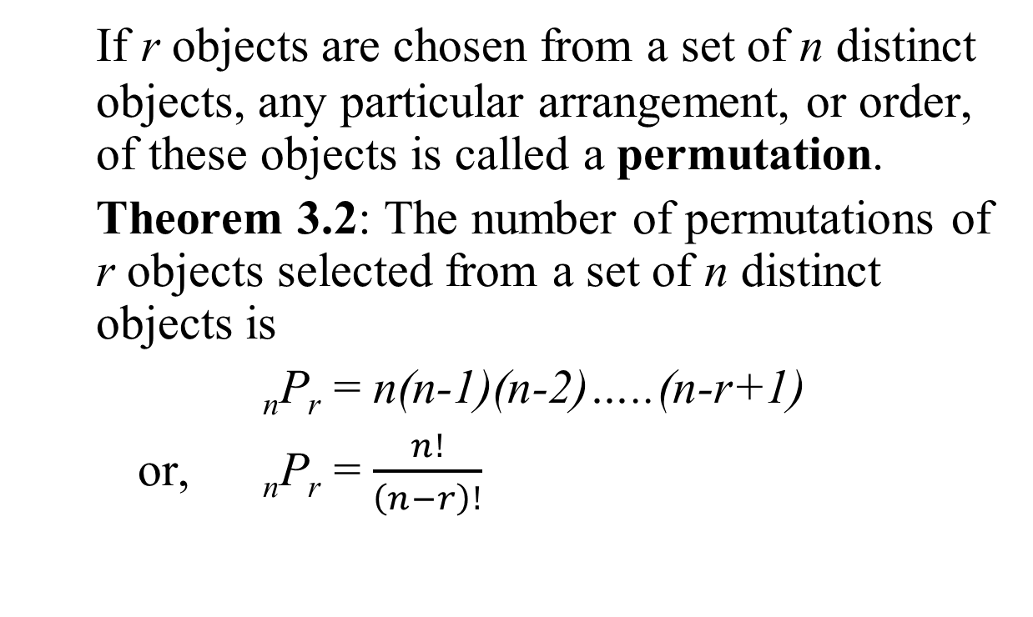
PROBABILITY
If r objects are chosen from a set of n distinct objects, any particular arrangement, or order, of these objects is called a permutation.
Theorem 3.2: The number of permutations of r objects selected from a set of n distinct objects is
_{n}P_{r} = n(n-1)(n-2)…..(n-r+1)
or, _{n}P_{r} = $\frac{n!}{\left(n−r\right)!}$

Slide 14
PROBABILITY
Combinations
Sometimes, we want to count all of the possible ways that a single set of objects can be selected - without regard to the order in which they are selected.
A combination is a selection of all or part of a set of objects, without regard to the order in which they were selected. This means that XYZ is considered the same combination as ZYX.
The number of combinations of n objects taken r at a time is denoted by _{n}C_{r}.

Slide 15
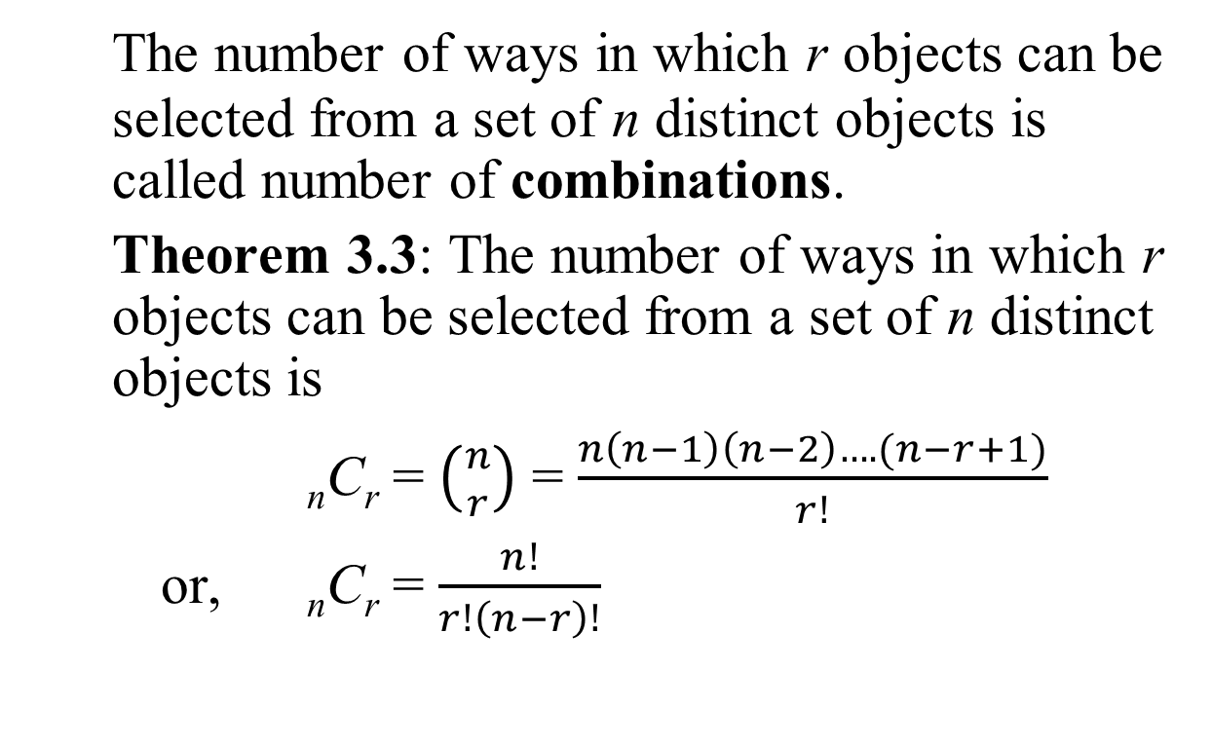
PROBABILITY
The number of ways in which r objects can be selected from a set of n distinct objects is called number of combinations.
Theorem 3.3: The number of ways in which r objects can be selected from a set of n distinct objects is
_{n}C_{r} = $\left({n \atop r}\right)$ = $\frac{n\left(n−1\right)\left(n−2\right)….(n−r+1)}{r!}$
or, _{n}C_{r} = $\frac{n!}{r!\left(n−r\right)!}$

Slide 16
PROBABILITY
Example 1
How many different ways can you select 2 letters from the set of letters: X, Y, and Z? (Hint: In this problem, order is NOT important; i.e., XY is considered the same selection as YX.)
Solution: One way to solve this problem is to list all of the possible selections of 2 letters from the set of X, Y, and Z. They are: XY, XZ, and YZ. Thus, there are 3 possible combinations.
Another approach is to use Rule 3. Rule 3 tells us that the number of combinations is n! / r!(n - r)!. We have 3 distinct objects so n = 3. And we want to arrange them in groups of 2, so r = 2. Thus, the number of combinations is 3! / 2!(3 - 2)! or 3! /2!1!. This is equal to (3)(2)(1)/(2)(1)(1) = 3.

Slide 17
PROBABILITY
Example 2
Five-card stud is a poker game, in which a player is dealt 5 cards from an ordinary deck of 52 playing cards. How many distinct poker hands could be dealt? (Hint: In this problem, the order in which cards are dealt is NOT important; For example, if you are dealt the ace, king, queen, jack, ten of spades, that is the same as being dealt the ten, jack, queen, king, ace of spades.)
Solution: For this problem, it would be impractical to list all of the possible poker hands. However, the number of possible poker hands can be easily calculated using Rule 3.
Rule 3 tells us that the number of combinations is n! / r!(n - r)!. We have 52 cards in the deck so n = 52. And we want to arrange them in groups of 5, so r = 5. Thus, the number of permutations is 52! / 5!(52 - 5)! or 52! / 5!47!. This is equal to 2,598,960 distinct poker hands.

Slide 18
PROBABILITY
Examples: evaluating a combination, selection of machines for an experiment, and number of choices of new researchers, on page 53

Slide 19
PROBABILITY
3.3 Probability
Classical probability concept: If there are m equally likely possibilities, of which one must occur and s are regarded as favorable, or as a “success,” then the probability of a “success” is given by s/m.
Examples: random selection of cards and random selection results in the equally likely case on page 56

Slide 20
PROBABILITY
The frequency interpretation of probability: The probability of an event (or outcome) is the proportion of times the event will occur in a long run of repeated experiments.
Examples: long-run relative frequency approximation to probability on page 57

Slide 21
PROBABILITY
3.4 Axioms of Probability
Axiom 1: 0 ≤ P(A) ≤ 1 for each event A in S
Axiom 2: P(S) = 1
Axiom 3: If A and B are mutually exclusive events in S, then
P(A U B) = P(A) + P(B)
Examples: Checking possible assignments of probability on page 59.

Slide 22
PROBABILITY
3.5 Some Elementary Theorems
Theorem 3.4: If A₁, A₂, …, A_{n} are mutually exclusive events in a sample space S, then
P(A₁ U A₂ U…….U A_{n} = P(A₁) + P(A₂)…+ P(A_{n})
Theorem 3.5: If A is an event in the finite sample space S, then P(A) equals the sum of the probabilities of the individual outcomes comprising A.

Slide 23
PROBABILITY
How to Interpret Probability
Mathematically, the probability that an event will occur is expressed as a number between 0 and 1. Notationally, the probability of event A is represented by P(A).
If P(A) equals zero, event A will almost definitely not occur.
If P(A) is close to zero, there is only a small chance that event A will occur.
If P(A) equals 0.5, there is a 50-50 chance that event A will occur.
If P(A) is close to one, there is a strong chance that event A will occur.
If P(A) equals one, event A will almost definitely occur.

Slide 24
PROBABILITY
Definitions and Notation
Before discussing the rules of probability, we state the following definitions:
Two events are mutually exclusive or disjoint if they cannot occur at the same time.
The probability that Event A occurs, given that Event B has occurred, is called a conditional probability. The conditional probability of Event A, given Event B, is denoted by the symbol P(A|B).
The complement of an event is the event not occurring. The probability that Event A will not occur is denoted by P(A').

Slide 25
PROBABILITY
The probability that Events A and B both occur is the probability of the intersection of A and B. The probability of the intersection of Events A and B is denoted by P(A ∩ B). If Events A and B are mutually exclusive, P(A ∩ B) = 0.
The probability that Events A or B occur is the probability of the union of A and B. The probability of the union of Events A and B is denoted by P(A ∪ B) .
If the occurence of Event A changes the probability of Event B, then Events A and B are dependent. On the other hand, if the occurence of Event A does not change the probability of Event B, then Events A and B are independent.

Slide 26
PROBABILITY
Rule of Subtraction
In a previous lesson, we learned two important properties of probability:
  The probability of an event ranges from 0 to 1.
  The sum of probabilities of all possible events equals 1.
  The rule of subtraction follows directly from these properties.
  Rule of Subtraction The probability that event A will occur is equal to 1 minus the probability that event A will not occur.P(A) = 1 - P(A')
Suppose, for example, the probability that Bill will graduate from college is 0.80. What is the probability that Bill will not graduate from college? Based on the rule of subtraction, the probability that Bill will not graduate is 1.00 - 0.80 or 0.20.

Slide 27
PROBABILITY
Rule of Multiplication
The rule of multiplication applies to the situation
when we want to know the probability of the
intersection of two events; that is, we want to know
the probability that two events (Event A and Event
B) both occur.
  Rule of Multiplication The probability that Events A and B both occur is equal to the probability that Event A occurs times the probability that Event B occurs, given that A has occurred. P(A ∩ B) = P(A) P(B|A)

Slide 28
PROBABILITY
Example
An urn contains 6 red marbles and 4 black marbles. Two marbles are drawn without replacement from the urn. What is the probability that both of the marbles are black?
Solution: Let A = the event that the first marble is black; and let B = the event that the second marble is black. We know the following:
In the beginning, there are 10 marbles in the urn, 4 of which are black. Therefore, P(A) = 4/10.
After the first selection, there are 9 marbles in the urn, 3 of which are black. Therefore, P(B|A) = 3/9.
Therefore, based on the rule of multiplication:
P(A ∩ B) = P(A) P(B|A)
P(A ∩ B) = (4/10) * (3/9) = 12/90 = 2/15

Slide 29
PROBABILITY
Rule of Addition
The rule of addition applies to the following situation. We have two events, and we want to know the probability that either event occurs.
Rule of Addition The probability that Event A or Event B occurs is equal to the probability that Event A occurs plus the probability that Event B occurs minus the probability that both Events A and B occur. P(A ∪ B) = P(A) + P(B) - P(A ∩ B)
Note: Invoking the fact that P(A ∩ B) = P( A )P( B | A ), the Addition Rule can also be expressed as
P(A ∪ B) = P(A) + P(B) - P(A)P( B | A )

Slide 30
PROBABILITY
Example
A student goes to the library. The probability that she checks out (a) a work of fiction is 0.40, (b) a work of non-fiction is 0.30, and (c) both fiction and non-fiction is 0.20. What is the probability that the student checks out a work of fiction, non-fiction, or both?
Solution: Let F = the event that the student checks out fiction; and let N = the event that the student checks out non-fiction. Then, based on the rule of addition:
P(F ∪ N) = P(F) + P(N) - P(F ∩ N)
P(F ∪ N) = 0.40 + 0.30 - 0.20 = 0.50

Slide 31
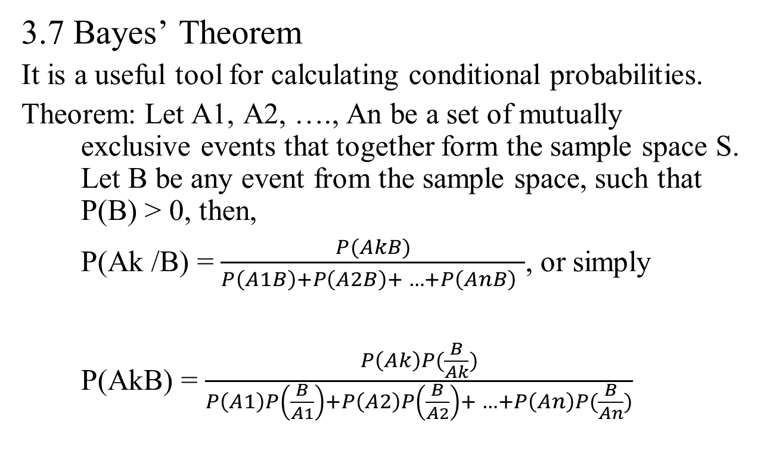
PROBABILITY
3.7 Bayes’ Theorem
It is a useful tool for calculating conditional probabilities.
Theorem: Let A1, A2, …., An be a set of mutually exclusive events that together form the sample space S. Let B be any event from the sample space, such that P(B) > 0, then,
P(Ak /B) = $\frac{P(AkB)}{P\left(A1B\right)+P\left(A2B\right)+ …+P\left(AnB\right) }$, or simply
P(AkB) = $\frac{P\left(Ak\right)P(\frac{B}{Ak})}{P\left(A1\right)P\left(\frac{B}{A1}\right)+P\left(A2\right)P\left(\frac{B}{A2}\right)+ …+P\left(An\right)P(\frac{B}{An})}$

Slide 32
PROBABILITY
When to Apply Bayes' Theorem
Part of the challenge in applying Bayes' theorem involves recognizing the types of problems that warrant its use. You should consider Bayes' theorem when the following conditions exist.
The sample space is partitioned into a set of mutually exclusive events { A₁, A₂, . . . , A_{n} }.
Within the sample space, there exists an event B, for which P(B) > 0.
The analytical goal is to compute a conditional probability of the form: P( A_{k} | B ).
You know at least one of the two sets of probabilities described below.
  P( A_{k} ∩ B ) for each A_{k}
  P( A_{k} ) and P( B | A_{k} ) for each A_{k}

Slide 33
PROBABILITY
Example 1
Marie is getting married tomorrow, at an outdoor ceremony in the desert. In recent years, it has rained only 5 days each year. Unfortunately, the weatherman has predicted rain for tomorrow. When it actually rains, the weatherman correctly forecasts rain 90% of the time. When it doesn't rain, he incorrectly forecasts rain 10% of the time. What is the probability that it will rain on the day of Marie's wedding?
Solution: The sample space is defined by two mutually-exclusive events - it rains or it does not rain. Additionally, a third event occurs when the weatherman predicts rain. Notation for these events appears below.
Event A₁. It rains on Marie's wedding.
Event A₂. It does not rain on Marie's wedding.
Event B. The weatherman predicts rain.

Slide 34
PROBABILITY
In terms of probabilities, we know the following: P( A₁ ) = 5/365 =0.0136985 [It rains 5 days out of the year.]
P( A₂ ) = 360/365 = 0.9863014 [It does not rain 360 days out of the year.]
P( B | A₁ ) = 0.9 [When it rains, the weatherman predicts rain 90% of the time.]
P( B | A₂ ) = 0.1 [When it does not rain, the weatherman predicts rain 10% of the time.]
We want to know P( A₁ | B ), the probability it will rain on the day of Marie's wedding, given a forecast for rain by the weatherman. The answer can be determined from Bayes' theorem, as shown below.
P( A₁ | B ) = | (0.014)(0.9) / [ (0.014)(0.9) + (0.986)(0.1) ]
P( A₁ | B ) = | 0.111

