Slide 1
PROBABILITY AND STATISTICS FOR ENGINEERS - I
Chapter 2
ORGANIZATION AND DESCRIPTION OF DATA

Slide 2
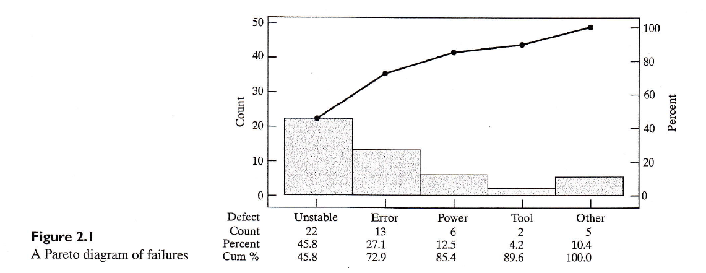
ORGANIZATION AND DESCRIPTION OF DATA
2.1 Pareto Diagrams and Dot Diagrams

Slide 3
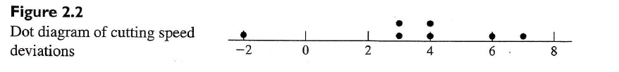
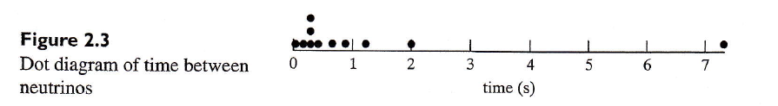
ORGANIZATION AND DESCRIPTION OF DATA
2.1 Pareto Diagrams and Dot Diagrams
Dot diagrams expose outliers

Slide 4
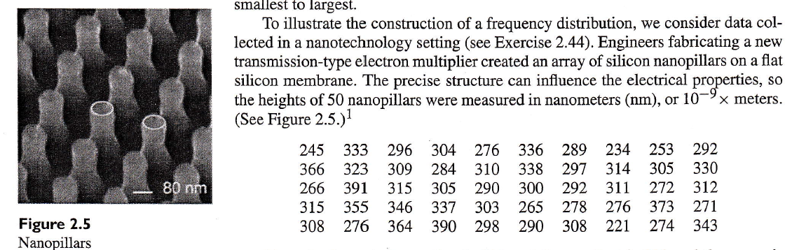
ORGANIZATION AND DESCRIPTION OF DATA
2.2 Frequency Distributions
Limits of classes Frequency
206-245 3
246-285 11
286-325 23
326-365 9
366-405 4

Slide 5
ORGANIZATION AND DESCRIPTION OF DATA
If the above data are taken as continuous, then the class intervals can be rewritten as
Limits of classes Frequency
205-245 3
245-285 11
285-325 23
325-365 9
365-405 4
where, the convention of only right boundary value being considered for each class, can be followed
Class marks and class interval for grouped data
Class mark = average of the two bounding values
Class interval = difference between the two bounding values.

Slide 6
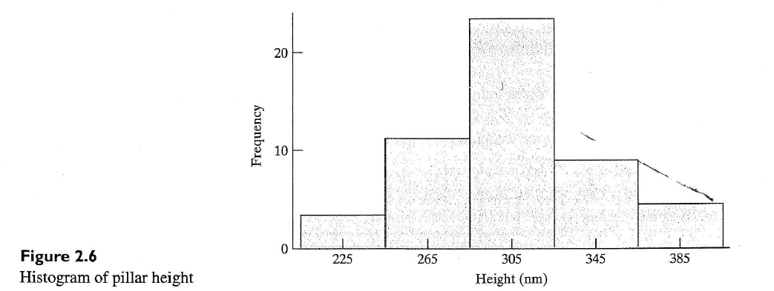
ORGANIZATION AND DESCRIPTION OF DATA
2.3 Graphs of Frequency Distributions

Slide 7
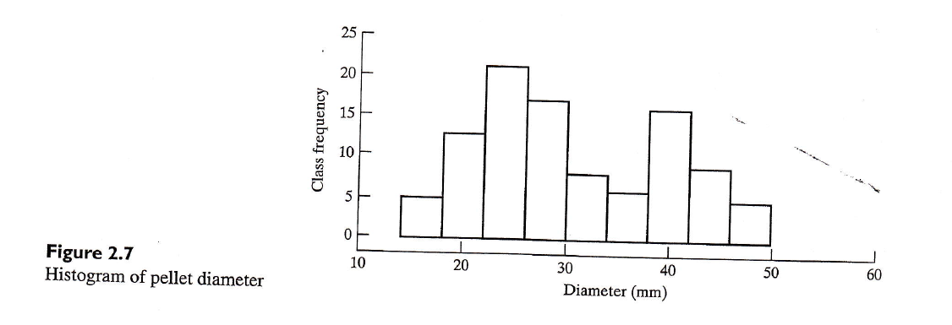
ORGANIZATION AND DESCRIPTION OF DATA
2.3 Graphs of Frequency Distributions
A histogram reveals the solution to a grinding operation problem

Slide 8
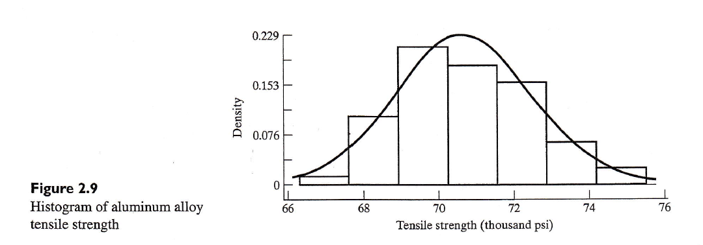
ORGANIZATION AND DESCRIPTION OF DATA
2.3 Graphs of Frequency Distributions
A density histogram has total area 1

Slide 9
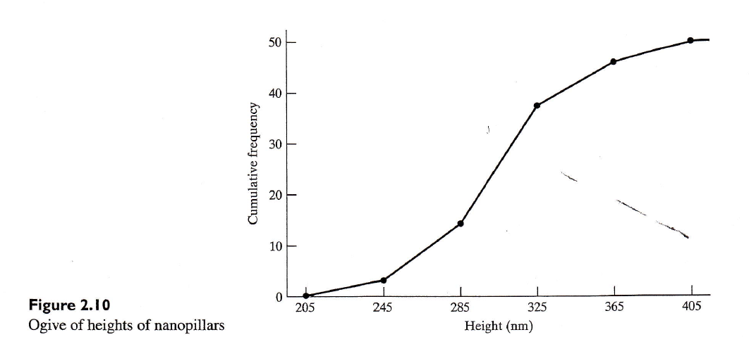
ORGANIZATION AND DESCRIPTION OF DATA
2.3 Graphs of Frequency Distributions

Slide 10
ORGANIZATION AND DESCRIPTION OF DATA
2.4 Stem-and-Leaf Displays
Previous methods involved in the loss of some information by grouping. This process yields an overall picture of the data without loss of information.
Example: consider the following humidity data rounded to the nearest percent,
29 44 12 53 21 34 39 25 48 23 17 24 27 32 34
15 42 21 28 37
Steps: 1. Arrange the data in ascending order
2. Form groups with equal intervals

Slide 11
ORGANIZATION AND DESCRIPTION OF DATA
3. Take the groups as stem and mark the numbers within the group as leaves. This will keep the information of the data.
4. Or write the tens digit of the data as stem and the units as leaves to form stem and leaves related to the data set.
5. There should not be a gap in the stem even if there is no leaf.

Slide 12
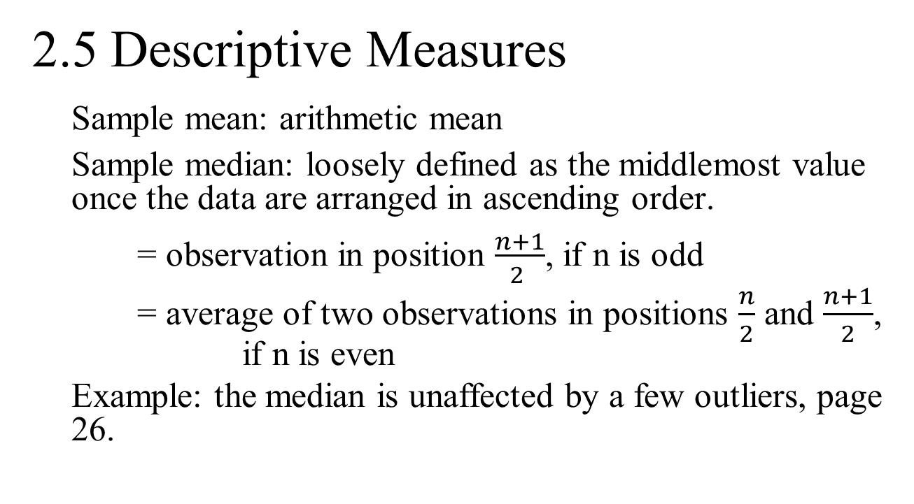
ORGANIZATION AND DESCRIPTION OF DATA
2.5 Descriptive Measures
Sample mean: arithmetic mean
Sample median: loosely defined as the middlemost value once the data are arranged in ascending order.
= observation in position $\frac{\begin{aligned} \\ n+1\end{aligned}}{2 }$, if n is odd
= average of two observations in positions $\frac{n}{2}$ and $\frac{n+1}{2}$, if n is even
Example: the median is unaffected by a few outliers, page 26.

Slide 13
ORGANIZATION AND DESCRIPTION OF DATA
Sample variance
Mean and median tell us about one aspect of the set of data – their “middle” or the “average.” But they do not tell about the other basic characteristic such as dispersion – that is the amount of deviation of the values from their mean. Thus for a set of numbers x₁, x₂, x₃,…x_{n} with a mean x,
x₁ – x, x₂ – x, ….., x_{n} – x
are called deviations from the mean.
Since the mean of deviation is always equal to zero, we cannot use the mean to describe the deviation.

Slide 14
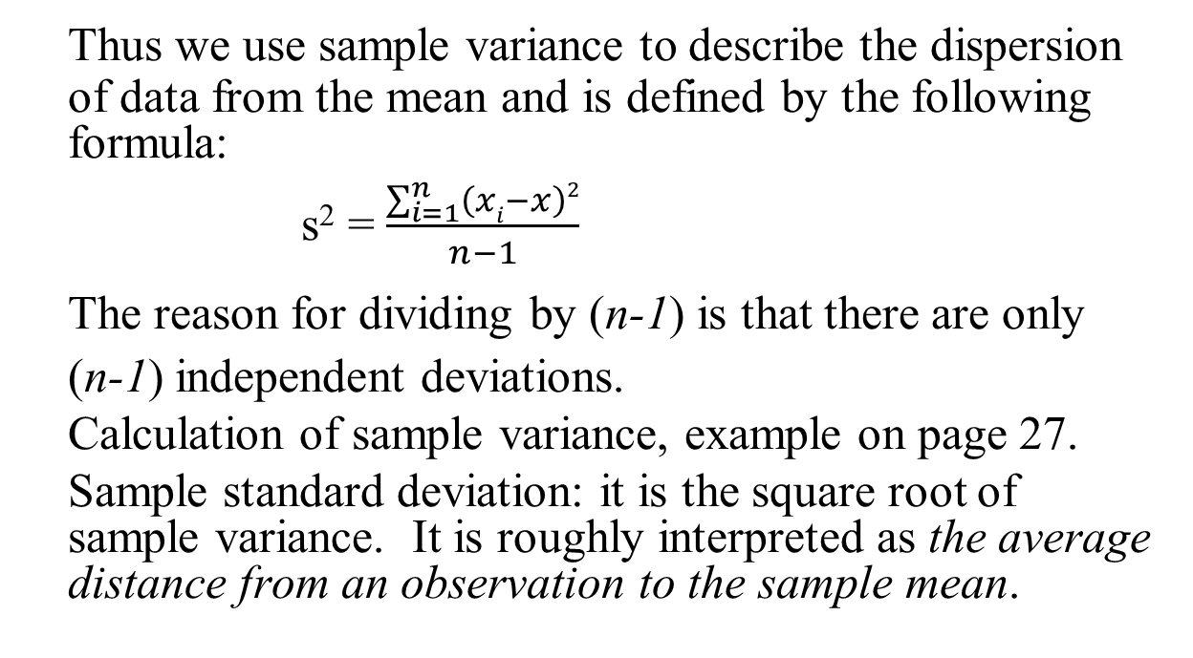
ORGANIZATION AND DESCRIPTION OF DATA
Thus we use sample variance to describe the dispersion of data from the mean and is defined by the following formula:
s² = $\frac{\sum_{i=1}^{n}{\left(xi−x\right)2}}{n−1}$
The reason for dividing by (n-1) is that there are only
(n-1) independent deviations.
Calculation of sample variance, example on page 27.
Sample standard deviation: it is the square root of sample variance. It is roughly interpreted as the average distance from an observation to the sample mean.

Slide 15
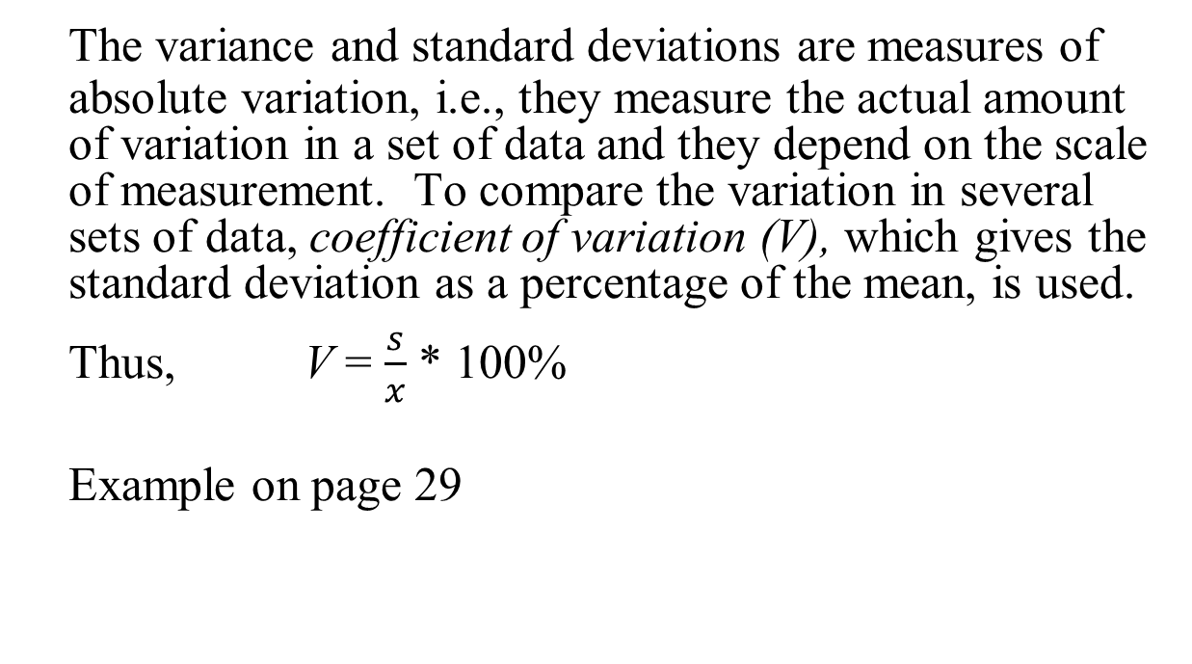
ORGANIZATION AND DESCRIPTION OF DATA
The variance and standard deviations are measures of absolute variation, i.e., they measure the actual amount of variation in a set of data and they depend on the scale of measurement. To compare the variation in several sets of data, coefficient of variation (V), which gives the standard deviation as a percentage of the mean, is used.
Thus, V = $\frac{s}{x}$ * 100%
Example on page 29

Slide 16
ORGANIZATION AND DESCRIPTION OF DATA
2.6 Quartiles and Percentiles
When an ordered set of data is divided into quarters, the resulting division points are called sample quartiles. The first quartile, Q1, is a value that has one-fourth, or 25%, of the observations below its value. It is also the sample 25th percentile P_{0.25} .
In general, the sample 100 pth percentile is a value such that at least 100p% of the observations are at or below this value, and at least 100(1-p)% are at or above this value.
The following steps provide simplified approach in the calculation of sample percentiles:

Slide 17
ORGANIZATION AND DESCRIPTION OF DATA
1. Order the observations from smallest to largest
2. Determine the product np.
If np is not an integer, round it up to the next integer and find the corresponding ordered value.
If np is an integer, say k, calculate the mean of kth and (k+1)st ordered observations.
Q₁ = 25th percentile
Q₂ = 50th percentile
Q₃ = 75th percentile
Example on page 30.

Slide 18
ORGANIZATION AND DESCRIPTION OF DATA
Range = maximum – minimum
Interquartile range = third quartile – first quartile
= Q₃ – Q₁
Example on page 31.
Boxplots

Slide 19
ORGANIZATION AND DESCRIPTION OF DATA
2.7 Calculation of x and s

Slide 20
ORGANIZATION AND DESCRIPTION OF DATA
2.8 A Case Study: Problems with Aggregating Data

