Slide 1
PROBABILITY AND STATISTICS FOR ENGINEERS - I
Chapter 1
INTRODUCTION

Slide 2
INTRODUCTION
1.1 Why Study Statistics?
  Can provide basis for making decisions
    e.g., determining whether the lead content in water in a city is within acceptable level
  Four crucial steps in collecting data for making decisions:
    Set clearly defined goals for the investigation
    Make a plan for data collection (what and how)
    Apply statistical methods to extract information from the data
    Interpret the information and draw conclusions.

Slide 3
INTRODUCTION
1.2 Modern Statistics
Mid-eighteenth century Games of chance leading to the treatment of errors of measurement became the foundation of modern statistics
Two types:
    Descriptive Statistics: at first, consisted of presentation of data in tables and charts. But now in involves summarization also
    Inferential Statistics: generalization based on sample data

Slide 4
INTRODUCTION
1.3 Statistics and Engineering
Used in solving production problems, effective use of materials and labor, basic research, and to develop new products. It enables an engineer to understand phenomenon subject to variation and how to control them effectively.

Slide 5
INTRODUCTION
1.4 Role of Scientist and Engineer in Quality Improvement
  Competitive world market leading to the revolution in quality improvement (QI)
  From design to production, processes need to be improved
  Scientists and engineers with technical and statistical knowledge can be a vital part of this process
  “Make it right the first time” – philosophy of quality improvement
  Quality improvement is a continuous process and the role of engineers and scientists cannot be over-emphasized.
  Reliability of products is another facet of QI

Slide 6
INTRODUCTION
1.5 A Case Study: Visually Inspecting Data to Improve Product Quality
A ceramic part used in coffee makers is made by filling the cavity between two dies of a pressing machine with a mixture of clay, water, and oil. Measurements of critical dimensions (mainly, depth of slot) are made before the part is dried and hardened.
Due to natural variation in the mixture, condition of press, difference in operators, etc., it is inevitable that the measurements will not be the same in all the cases.
See the data given in Table 1.1, Page 4.

Slide 7
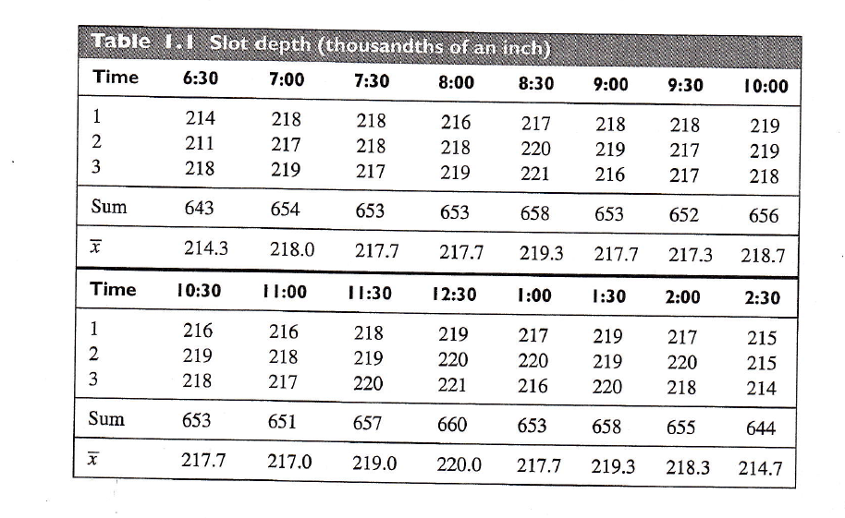
INTRODUCTION

Slide 8
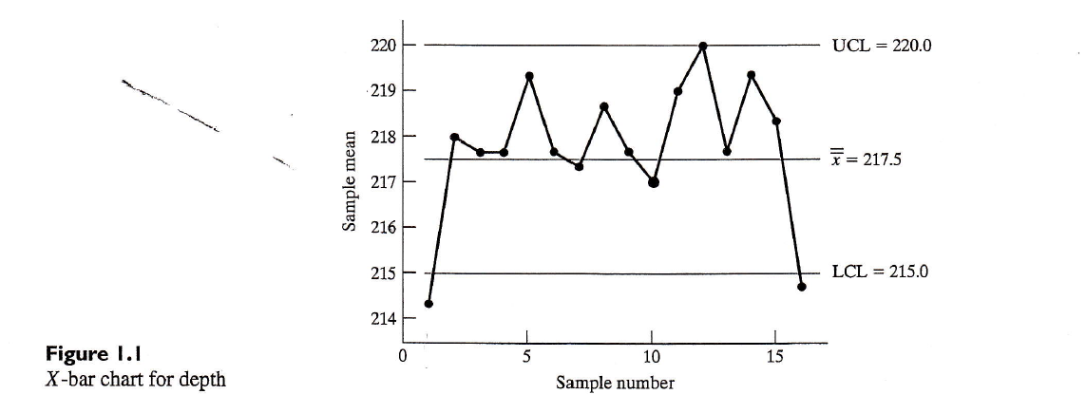
INTRODUCTION

Slide 9
INTRODUCTION
1.6 Two Basic Concepts – Population and Sample
Unit: a single entity, usually an object or person, whose characteristics are of interest
Population of units: complete collection of units about which information is sought
Statistical Population: set of all measurements (or record of some quality trait) corresponding to each unit in the entire population of units about which information is sought.
Sample: is the subset of measurements that are actually collected in the course of an investigation.

Slide 10
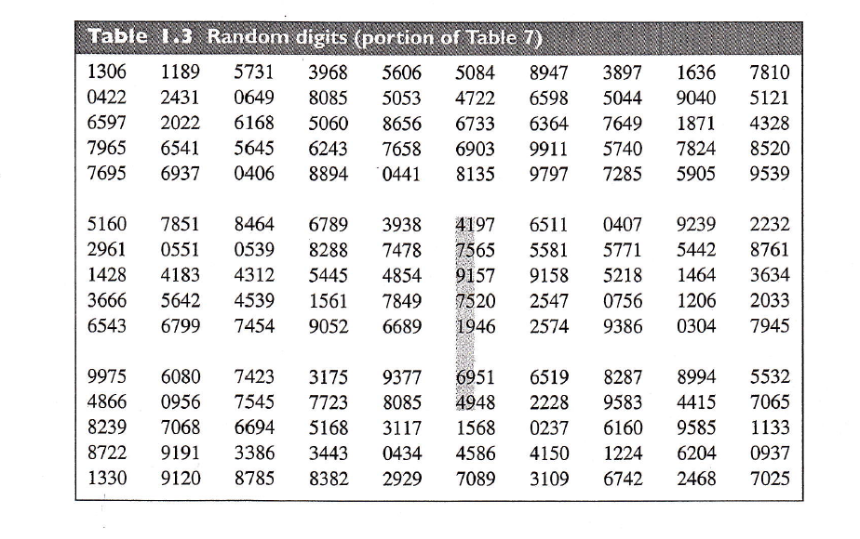
INTRODUCTION
Using a Random Number Table to Select Samples.

Slide 11
INTRODUCTION
Example: “Self-selected sample – a bad practice”
Example: Selecting a sample by random digit dialing.
Do’s: 1. Create a clear statement of purpose before deciding upon which variable to observe
2. Carefully define the population of interest
3. Whenever possible, do select samples using a random device or random number table
Don’ts: Don’t unquestioningly accept self-selected samples

